Slide 1
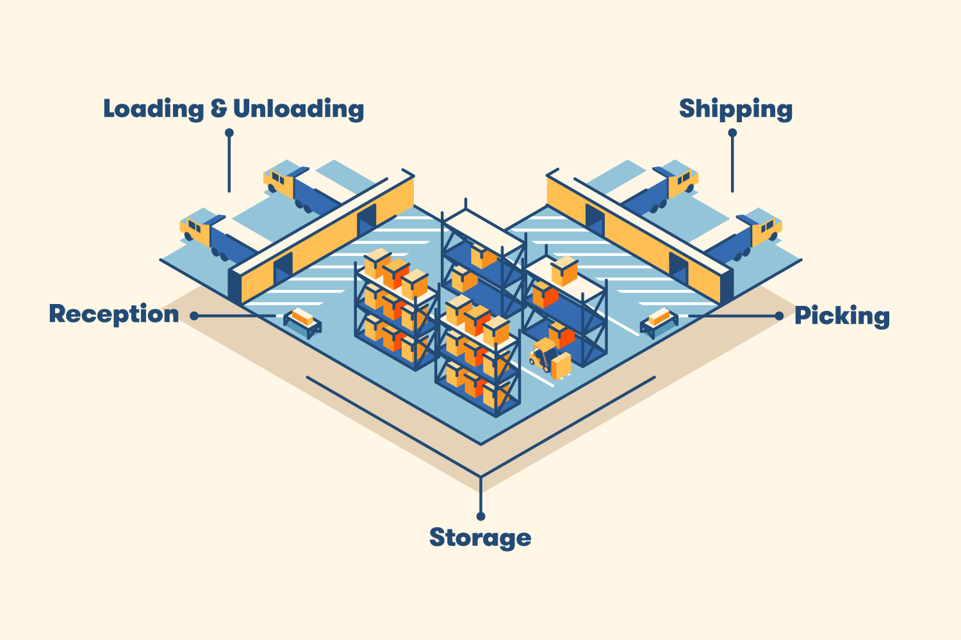
Warehouse layout – L shaped design
Source: www.bigrentz.com/blog/warehouse-layout

Slide 2
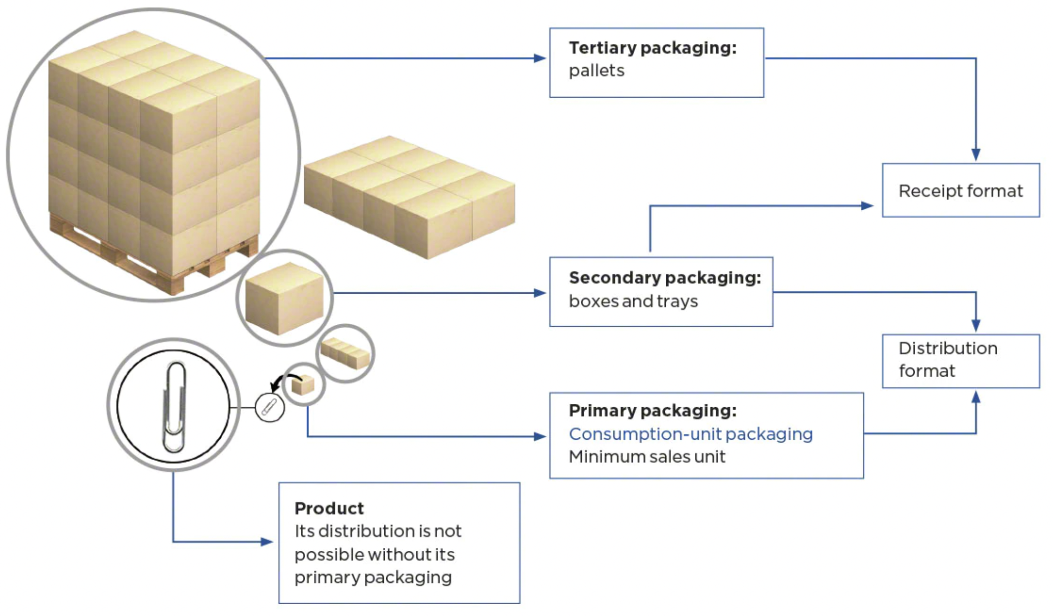
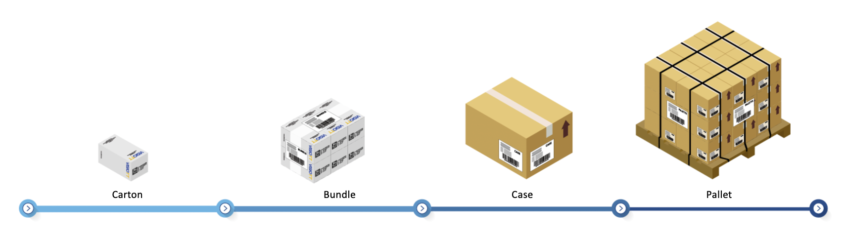
Product packaging and handling units
Source: Interlake Mecalux
Source: VISIOTT

Slide 3
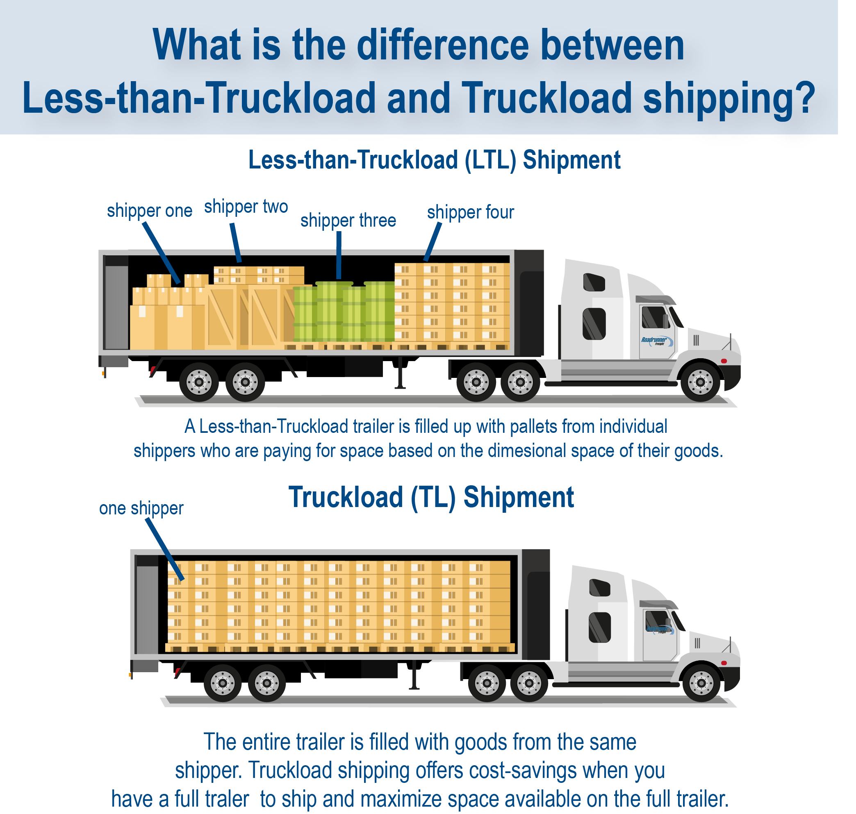
Difference between LTL and FTL
Source: Road Runner

Slide 4





































Retail Orientation
Process and software perspectives of retail business
PLAN
SOURCE
MOVE
SELL
Notes:
Outbound - Picking & Packing
Shipment planning - Carrier allocation, rate shopping, Label printing
Truckload planning/ Loading
Return to vendor
Slotting optimization
Audit Trail – Who did what when
Material handling Integration
Wave planning
Profiling
receiving-dock appointments

Slide 5
Retail Orientation
Aptos Solution Portfolio
Aptos Point of Sole
Aptos One Store Selling App
Aptos Order Management System
Fixed
Store Fulfillment App
Aptos One Store Inventory Management
Aptos One Unified Promos
Unified Commerce Vertical
Aptos One Enterprise Web Apps
Aptos Merchandising
Aptos CRM
Aptos Analytics
Aptos Warehouse Management System
Aptos Sales Audit
Pricing
Promotion Planning
Markdown Optimization
Revionics Vertical
Notes:
Aptos One Store Inventory Management

Slide 6
Retail Intro
Retail evolution: A marketer perspective
Dimension | Deal/Discount | Markdown
Objective | A marketing tool to stimulates sales by attracting, acquiring, inducing purchase and retaining customers through way of incentivizing them | It’s a tool to manage inventory to clear out stock if it’s moving slower than expected, or reduce risk of obsolescence when nearing end of the season or shelf life and expiration or end of lifecycle. Markdowns are also done for damaged goods and due to competition (also called price-matching) Markdown usually have implication of devaluing products so that customer can see better outcome in their cost-benefit analysis
Time-horizon | Promotional discounts are typically time-limited and offered for a specific period, such as a weekend sale, holiday promotion (cyber-Monday and black Friday), back to school | Could be for shorter period to clear out the stocks and called temporary markdown. Permanent markdowns happen in wake of new launches, damaged goods or competition
Product Lifecycle | Usually happens at the launch stage of the lifecycle | Usually happens at the end of the lifecycle. Example – Cars or phones when new version is about to be released
Communication | Usually done quite aggressively to create awareness, generate excitement and drive traffic | Less active promotions. Markdowns are generally indicated through tags and signages
Scope | Multiple different types are offered across a wide-range of products and categories in forms such as pay lesser price through amount/percentage off/BOGO/GWP | Markdowns are typically applied to specific products or categories that are not meeting sales expectations or need to be cleared out.

Slide 7

Orientation Program on Retail
Day 2

Slide 8
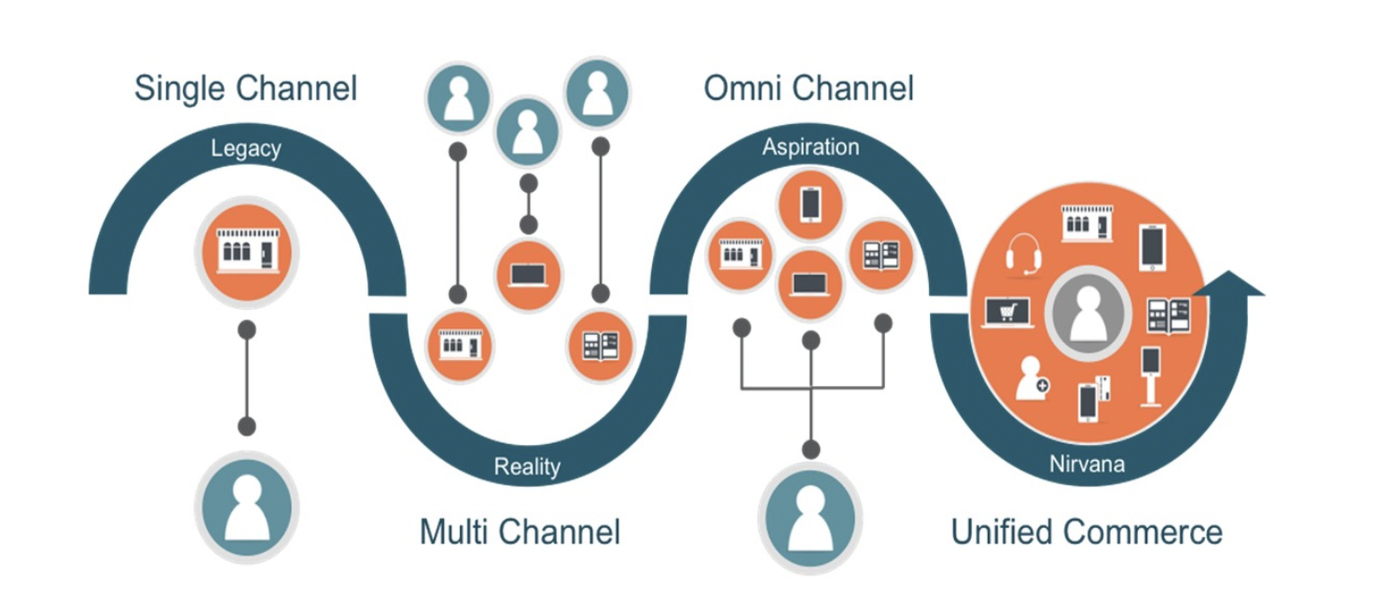
Retail Orientation
Evolution of customer engagement models in retail
Brick-and-mortar retailers have to think of e-commerce as a serious business in its own right and not compromise its success in an effort to protect the traditional physical model - Getting Real About Virtual Commerce, HBR, 1999
Most e-Commerce retailers place initial emphasis on the “exciting” areas: Web product development, traffic generation, etc. Often, they give little thought to order fulfilment—a capability critical to the success or failure of Web commerce - Order Fulfillment: The Hidden Key to e-Commerce Success, 1999
SINGLE CHANNEL
MULTI CHANNEL
OMNI CHANNEL
UNIFIED COMMERCE
Retailer offers only one channel (mainly offline) to sell products to customers
Conventional operating model followed in retail until internet disrupted it
Retailer offers multiple channels to sell products
Every channel acting independently of each other
Process and data existed in technical and functional silos
Connected, consistent and coordinated customer across all channel and touchpoints
Requires one version of truth experience customers, merchandise, price, promo inventory, orders
One platform for multiple experiences
Practice of inter-connecting channels and touchpoints with their supporting back-end systems via a single platform
“We had a very steep learning curve, but we’re getting a lot better at e-commerce. We’ll be the first multichannel retailer to offer pervasive service on a massive scale” - Stephen Riggio, Barnes and Noble’s Vice-chairman, 2001
Omnichannel shoppers will spend over 20 percent more than multichannel consumers – IDC report, 2010
Omnichannel is not just for the Front End anymore – Chain Store Age, 2013
Unified commerce is now the number one priority for retailers and will drive the most technology spend – IHL, 2015

Slide 9
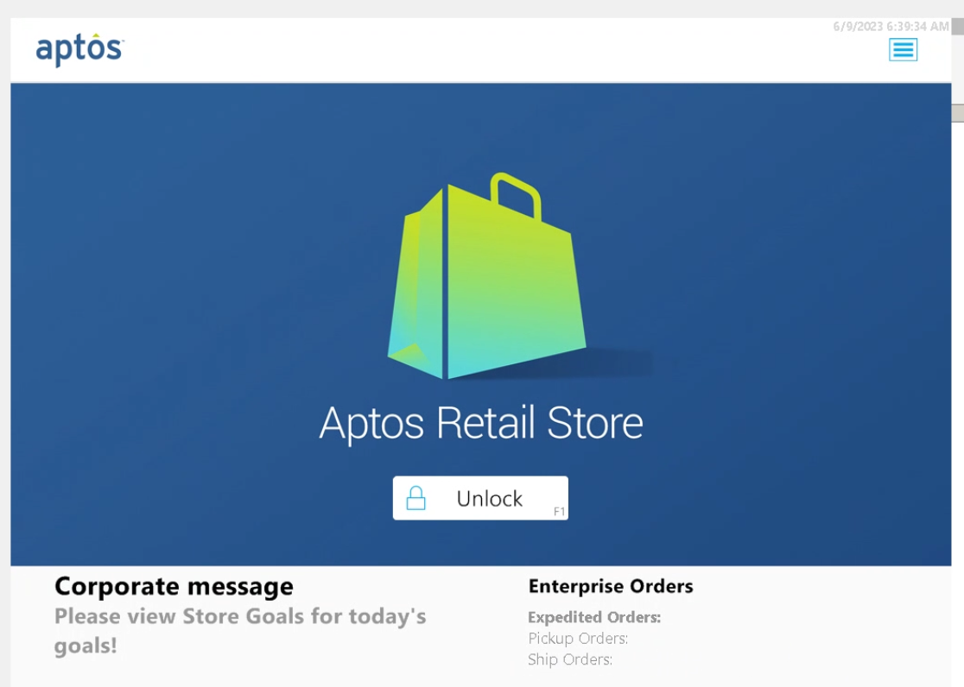
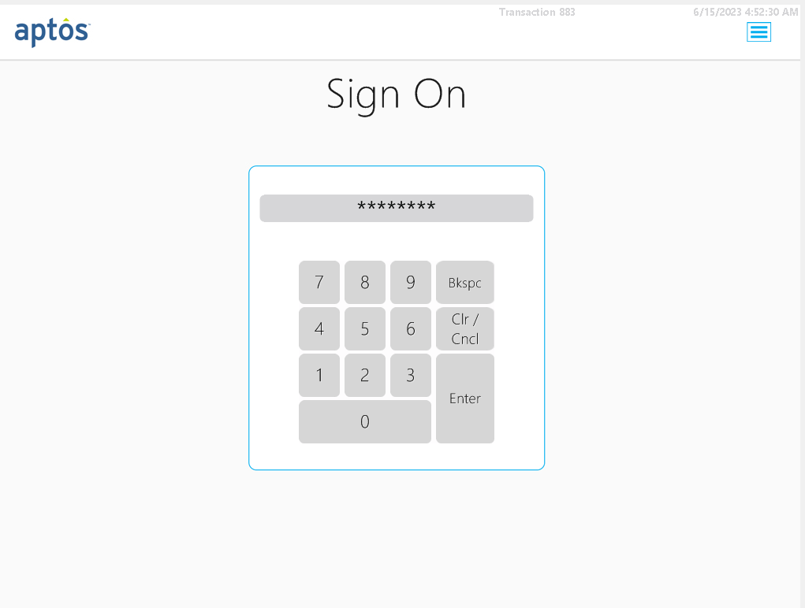
Aptos Store - Fixed Point Of Sale

Slide 10
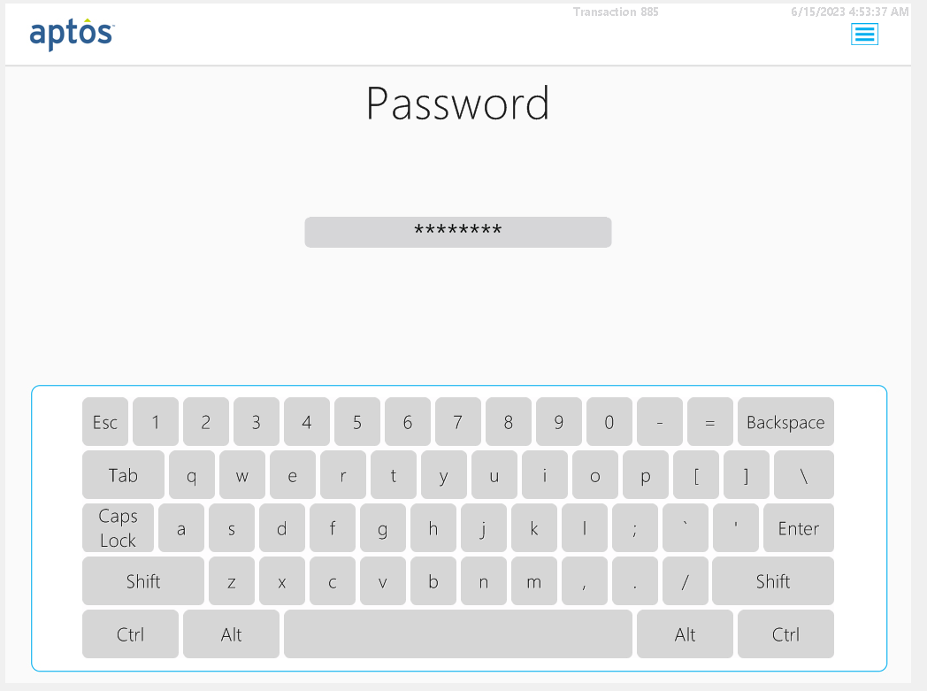
Aptos Store - Fixed Point Of Sale
Aptos Store - Fixed Point Of Sale

Slide 11
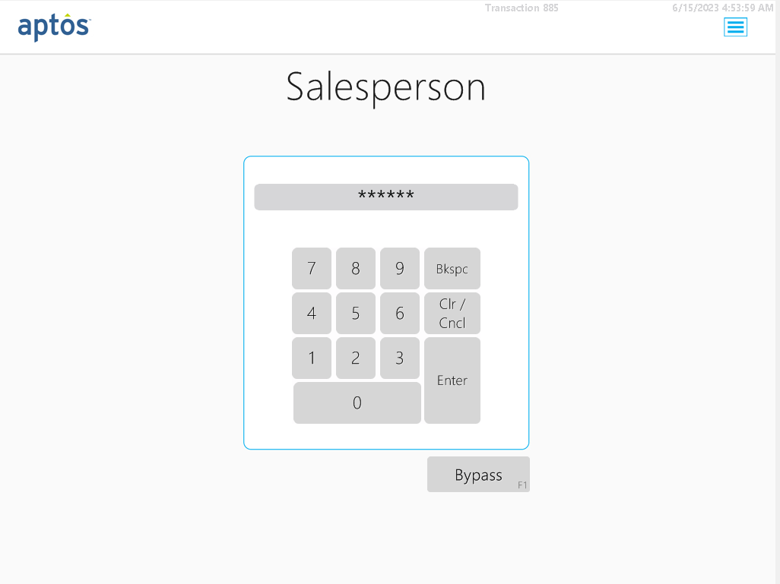
Aptos Store - Fixed Point Of Sale
Sales Associate Login Screen
Enter UserName

Slide 12
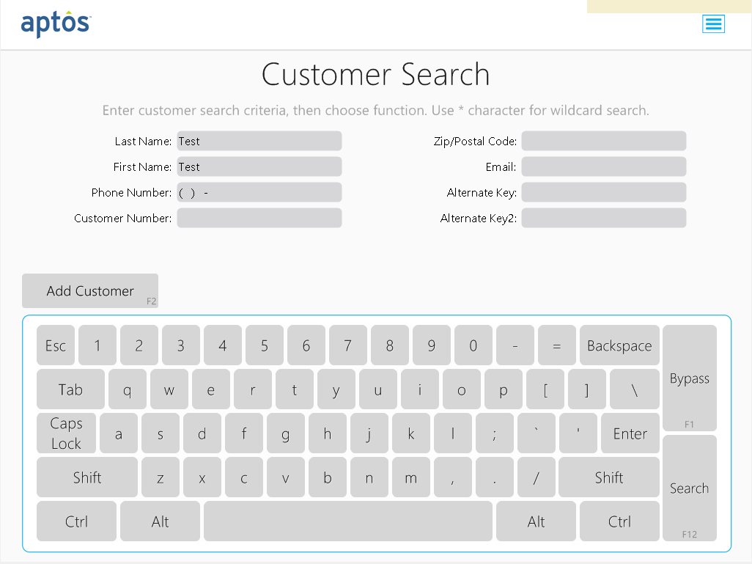
Aptos Store - Fixed Point Of Sale
Customer Search Screen
Search with LastName
Search with FirstName
Wildcard Search

Slide 13
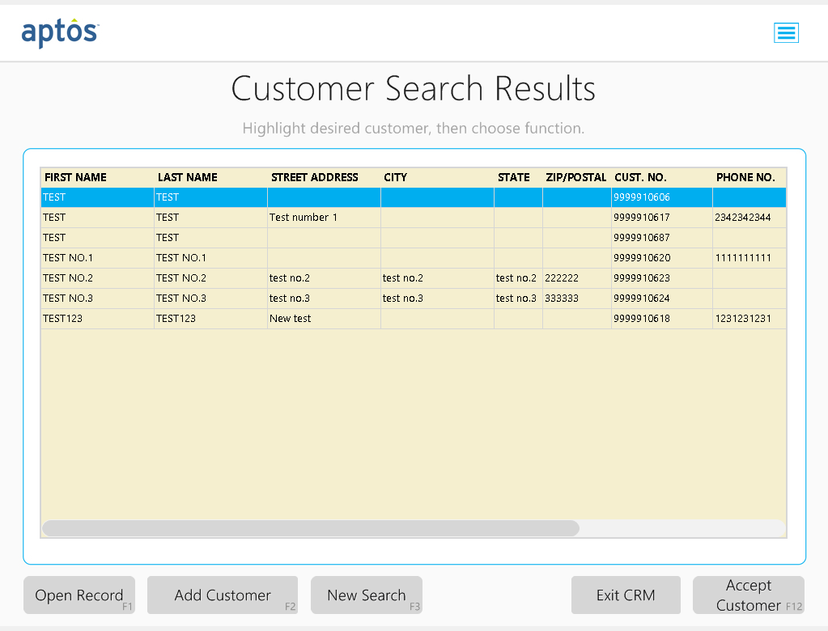
Aptos Store - Fixed Point Of Sale
Search results based on search criteria to choose a specific customer to assign to basket

Slide 14
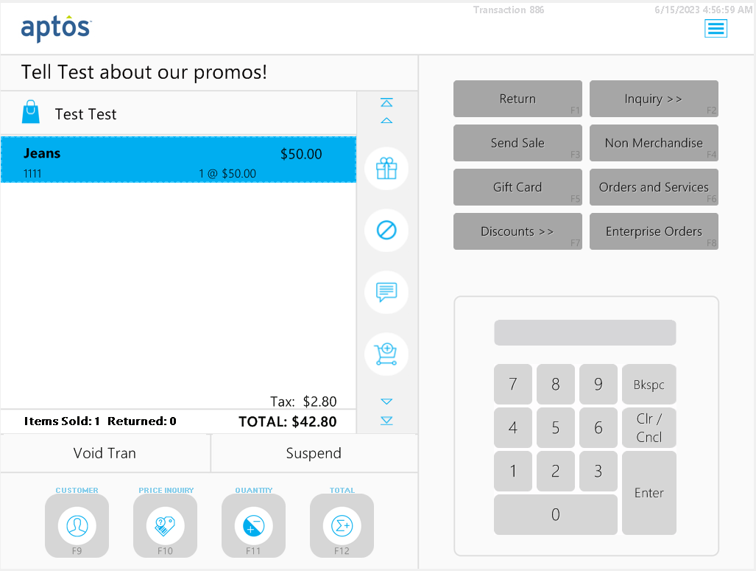
Aptos Store - Fixed Point Of Sale
Product added to basket for a sale transaction

Slide 15
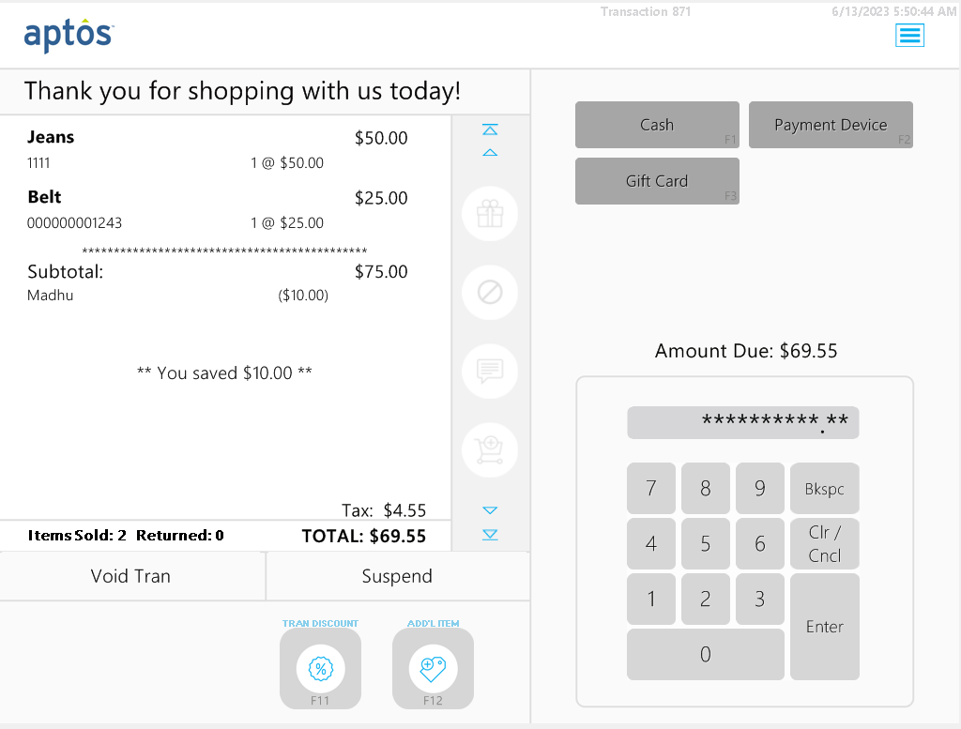
Aptos Store - Fixed Point Of Sale
Checkout with various payment options

Slide 16
Aptos Store - Fixed Point Of Sale
Key Features :
Sale
PostVoid
Suspend
Resume
Return
Exchange
Add SalesPerson
Assign Customer
Create Customer
Edit Customer
Print Receipt
Email Receipt
Gift cards
Cash
Card
Discount
Add Zero Priced items
Employee Discounts
Many more…
Stationary POS limitations
Immobile and heavy infrastructure set up
Long queues
Assisted checkout process
Less customer engagement

Slide 17
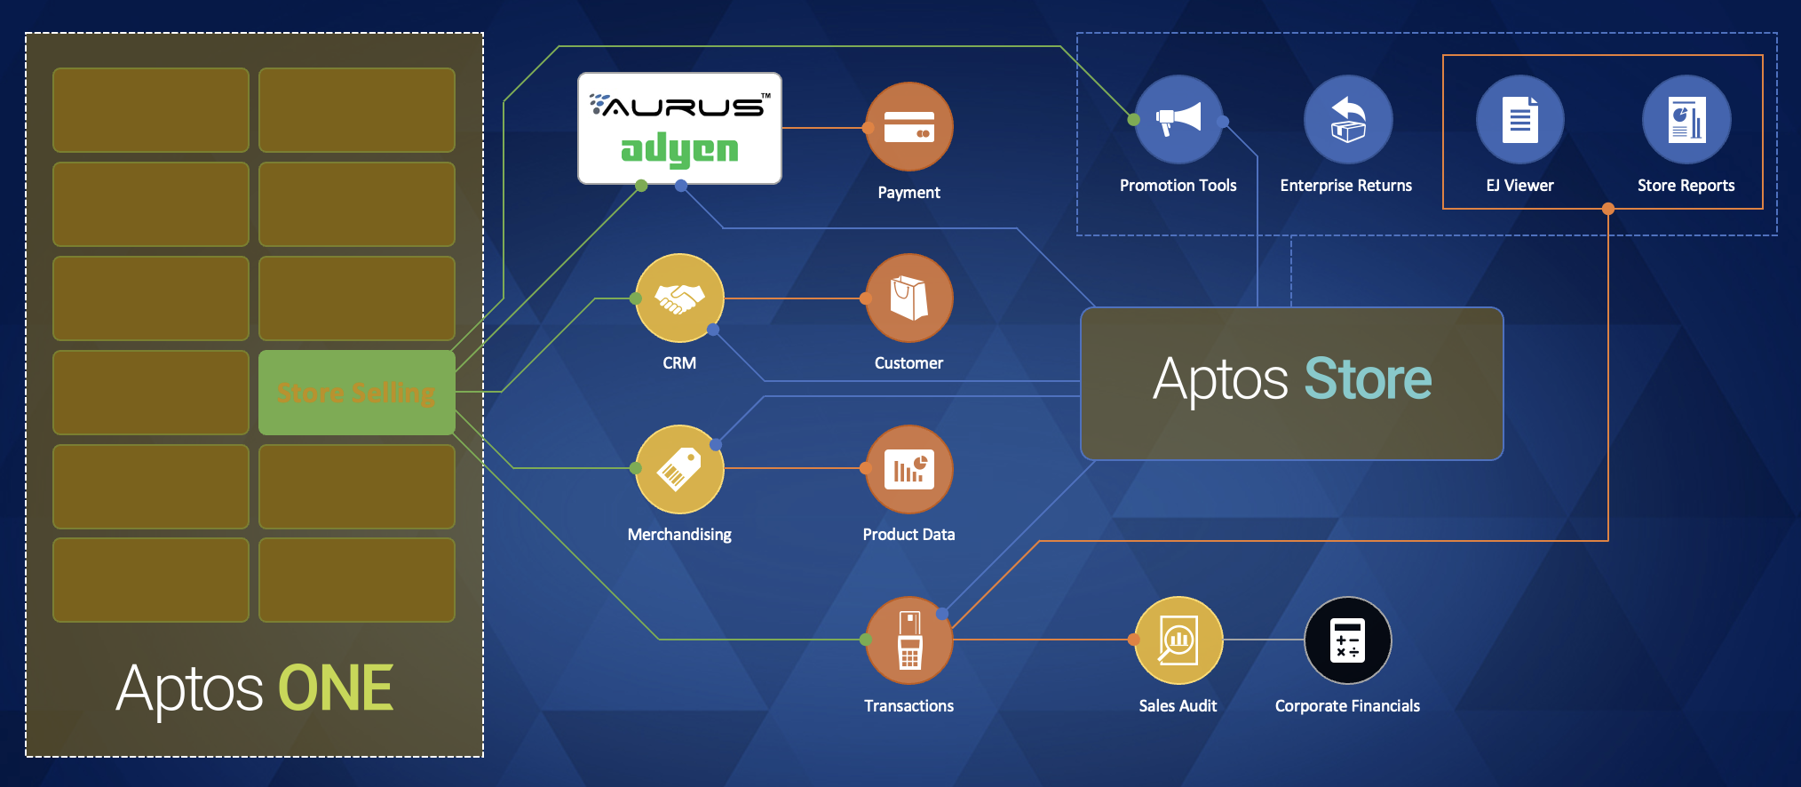


Aptos One Store Selling App

Slide 18
Aptos One Store Selling App
Why Aptos One ??
Mobility
Easy checkout without having to wait in long queues
Better customer engagement
Good Customer Service
Supported for both iOS as well as android
Customer has more flexibility to modify the cart before checkout
Reduce store associates exclusively for checkout
Time Saving
Easy upgrades
Increased Sales
Mobile first
Mobile devices has become the focus of system design. It not an add-on to a traditional store platform but an independent device.
Flexibility of having the right device for the right task (mobile and/or fixed lane)
Reduce the complexity and ‘weight’ of the hardware footprint in stores with a mobile-first design approach that does not compromise system availability and performance
Updates made easy

Slide 19
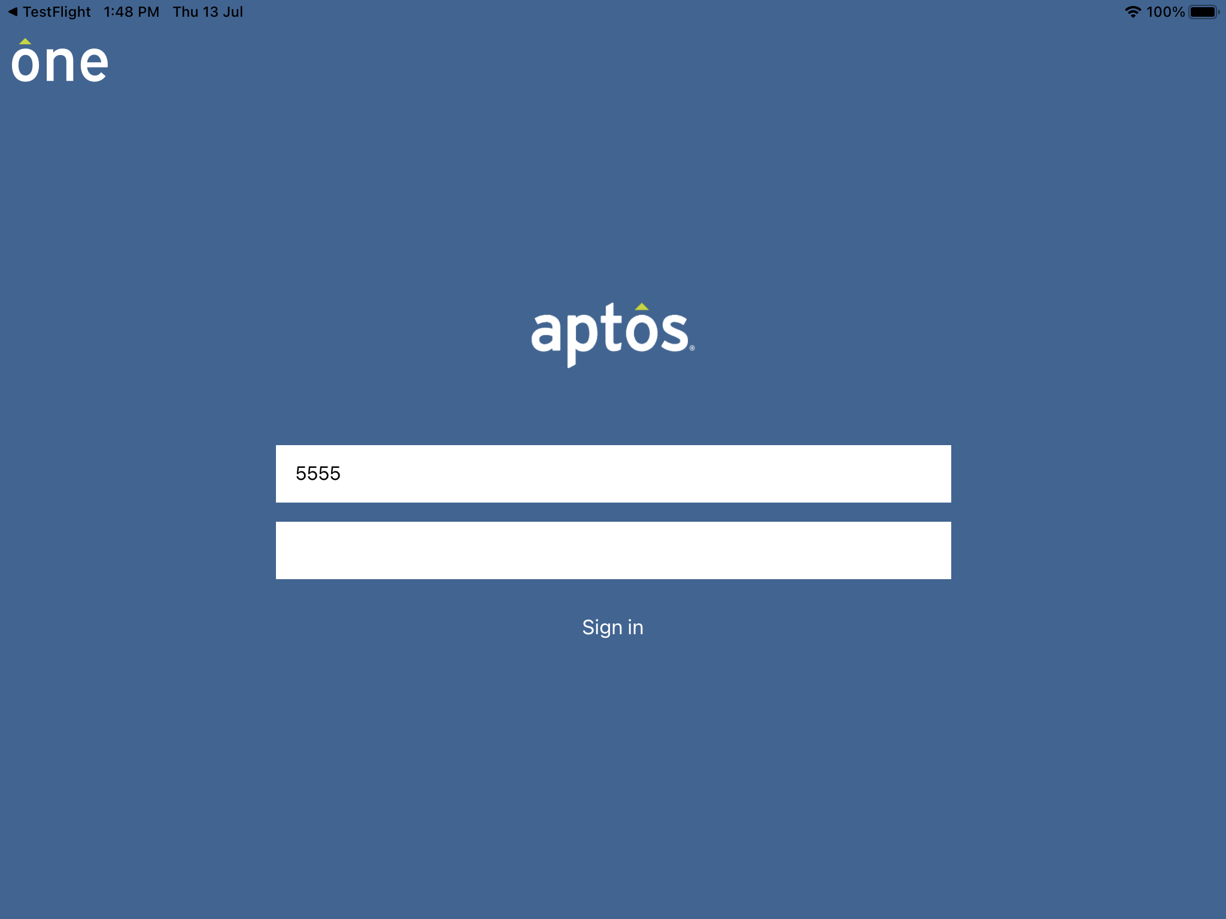
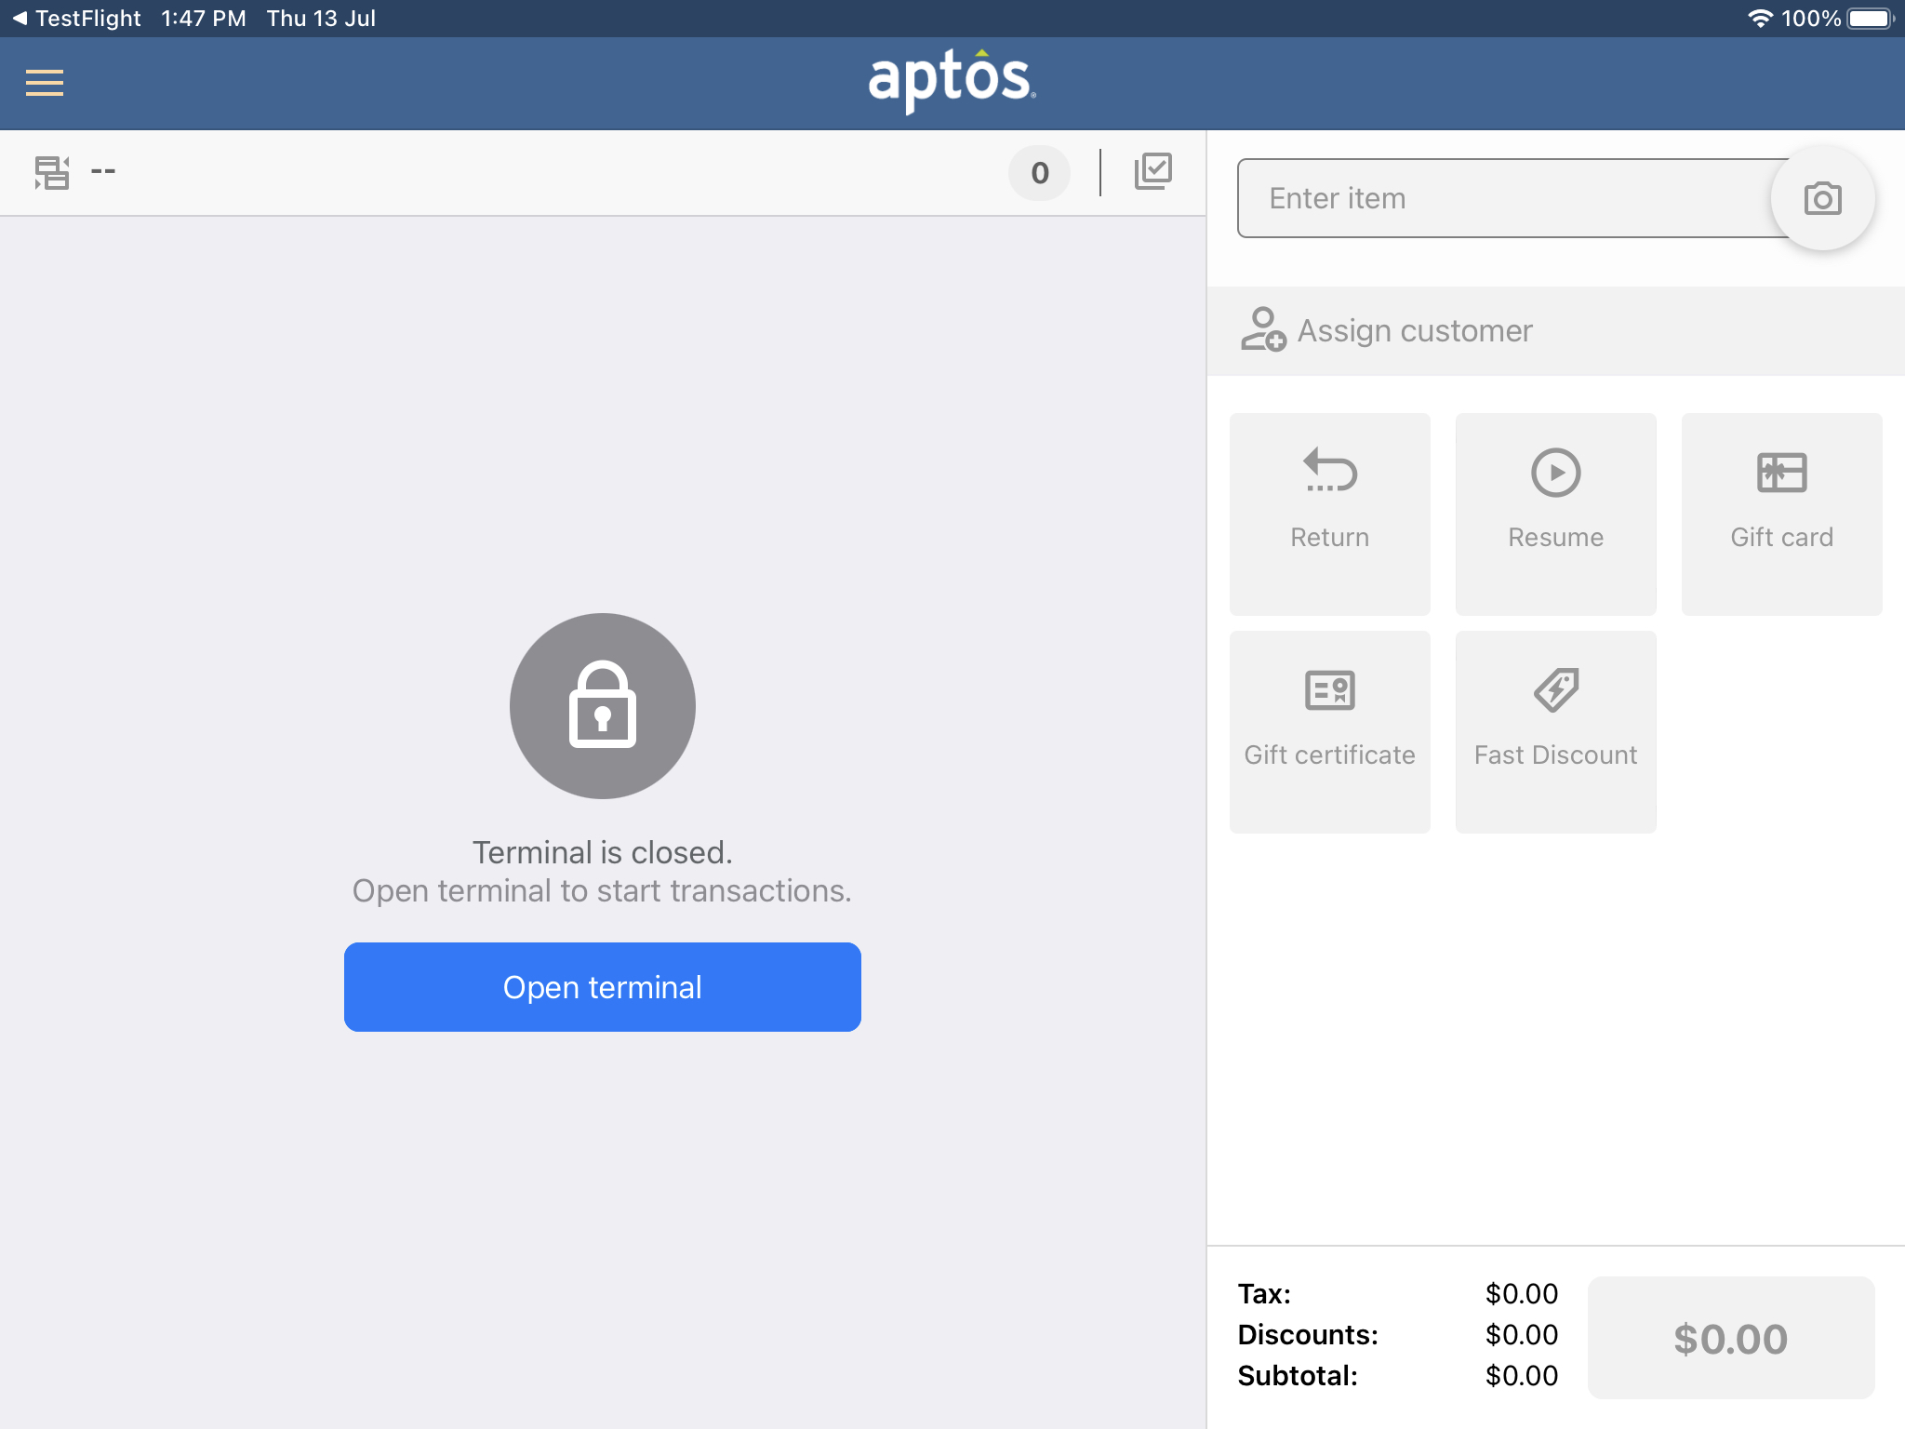
Aptos One Store Selling App
Login screen of Aptos one to enter Sales associate credentials
Initial screen after login

Slide 20
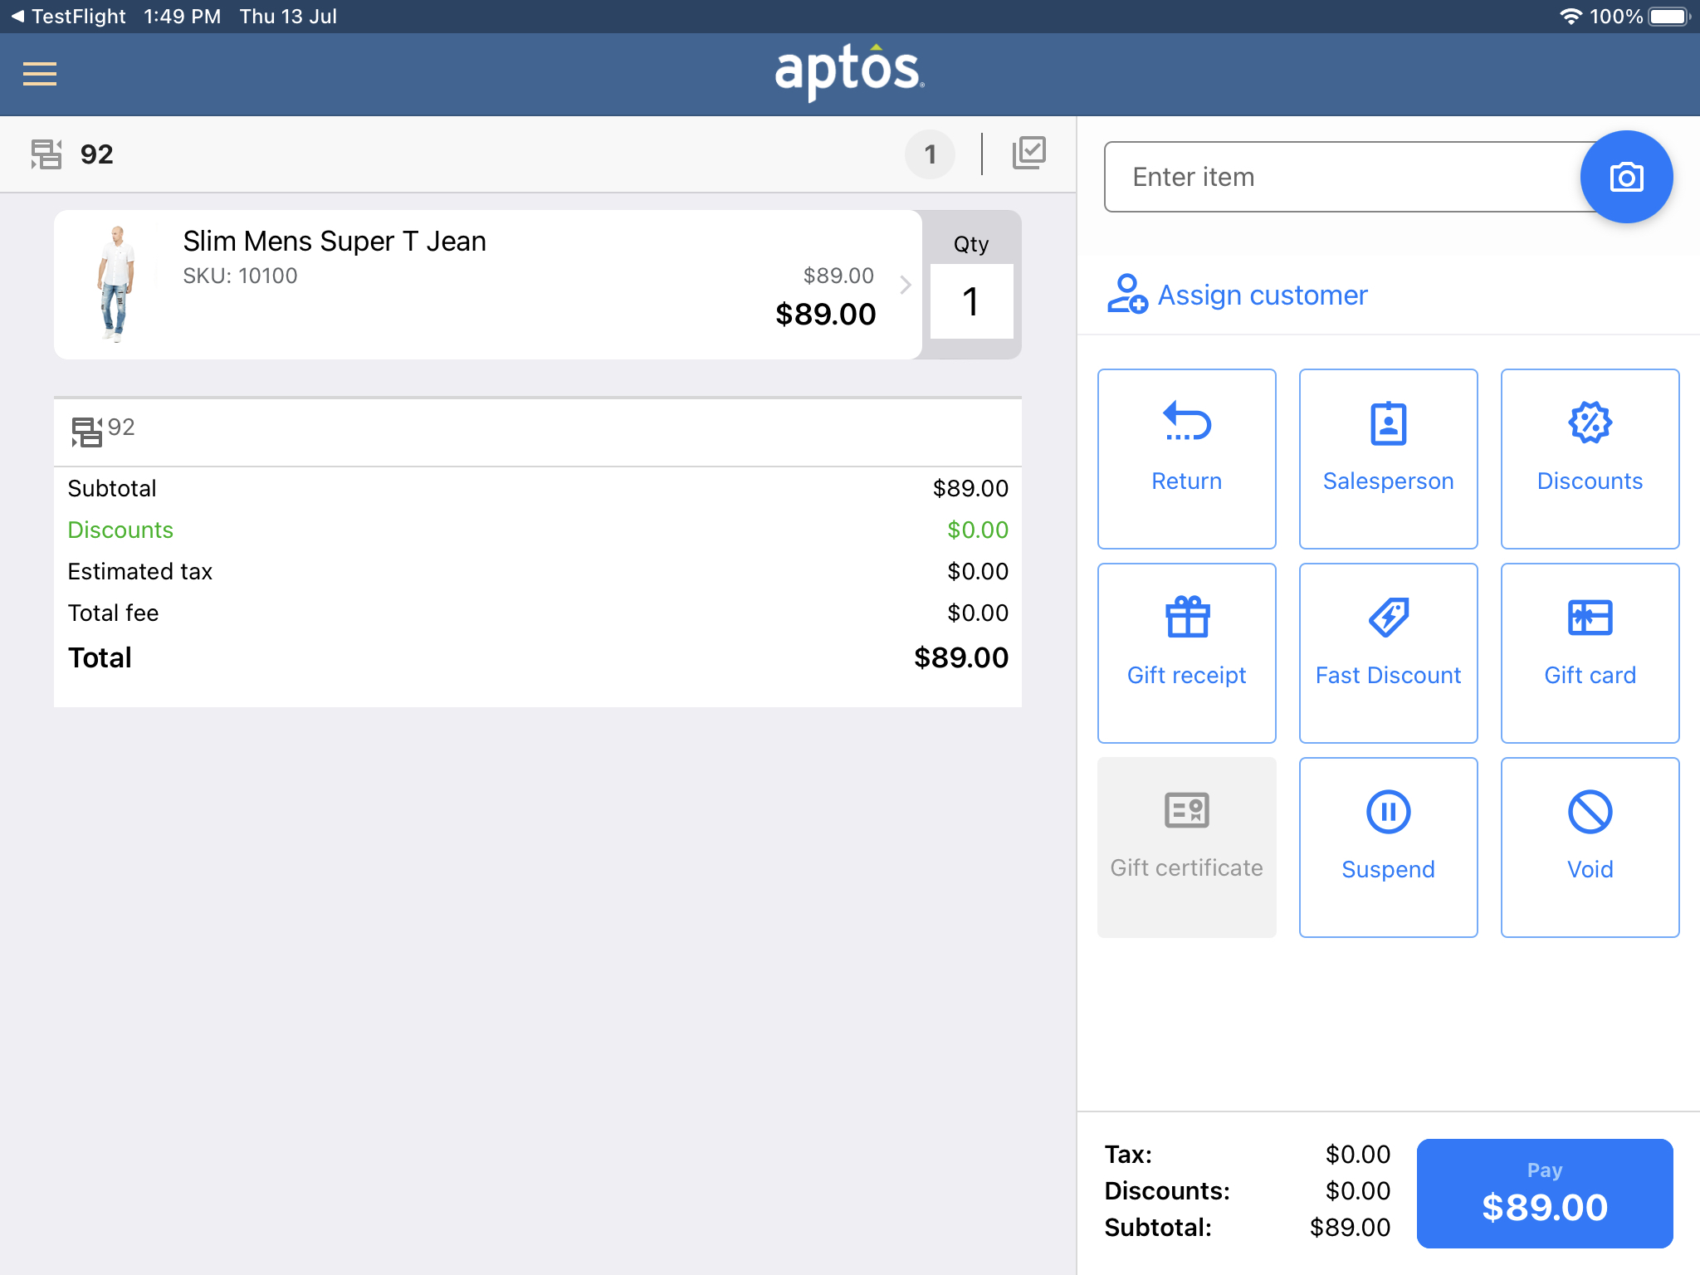
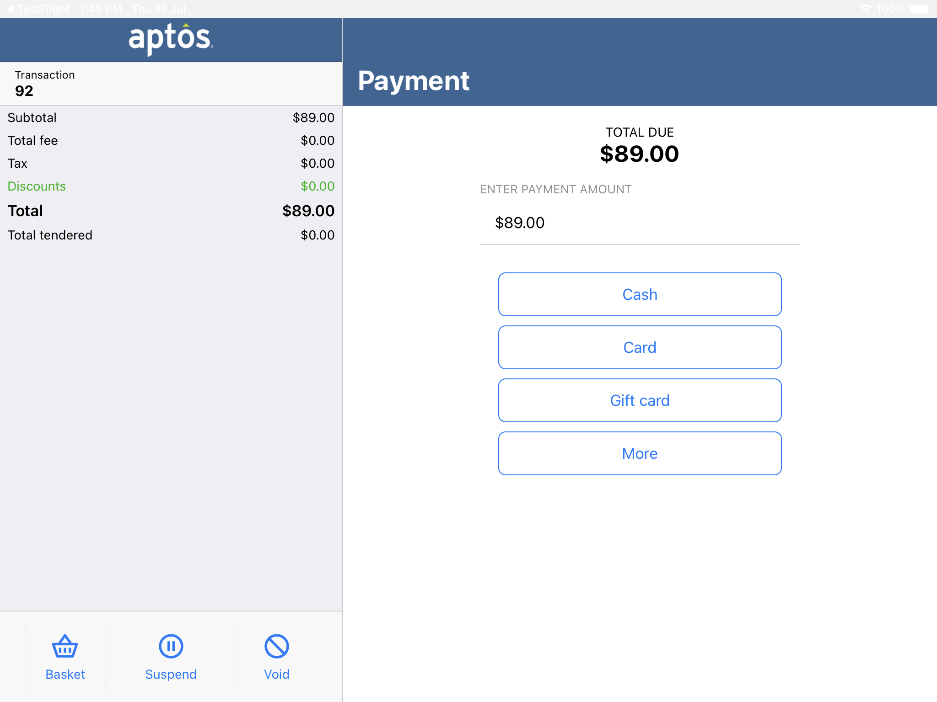
Aptos One Store Selling App​
Add an item to basket via scanning, product Id
Assign a customer if required
Proceed toward checkout

Slide 21
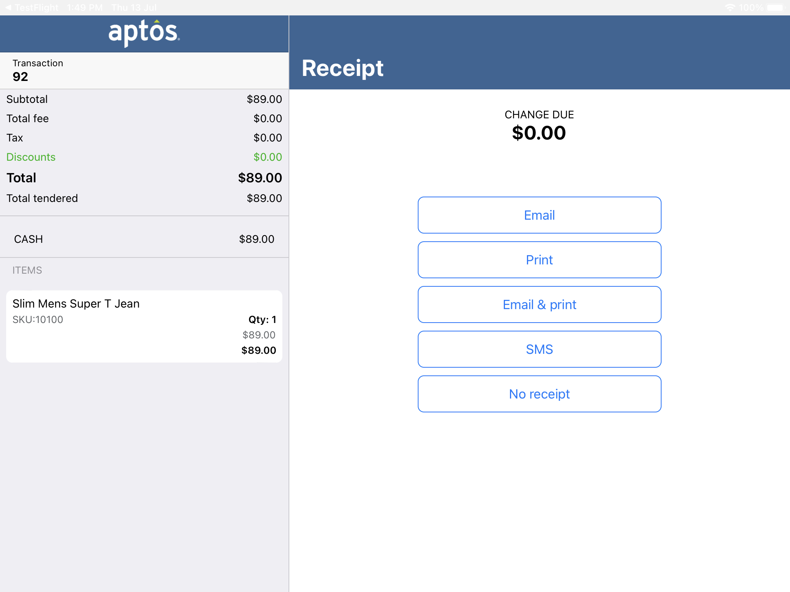
Aptos One Store Selling App ​
Checkout choosing any payment option like cash, card, GiftCard, Store Credit, Value Certificate
Receipt via Email, Print, SMS and also an option to choose No Receipt

Slide 22
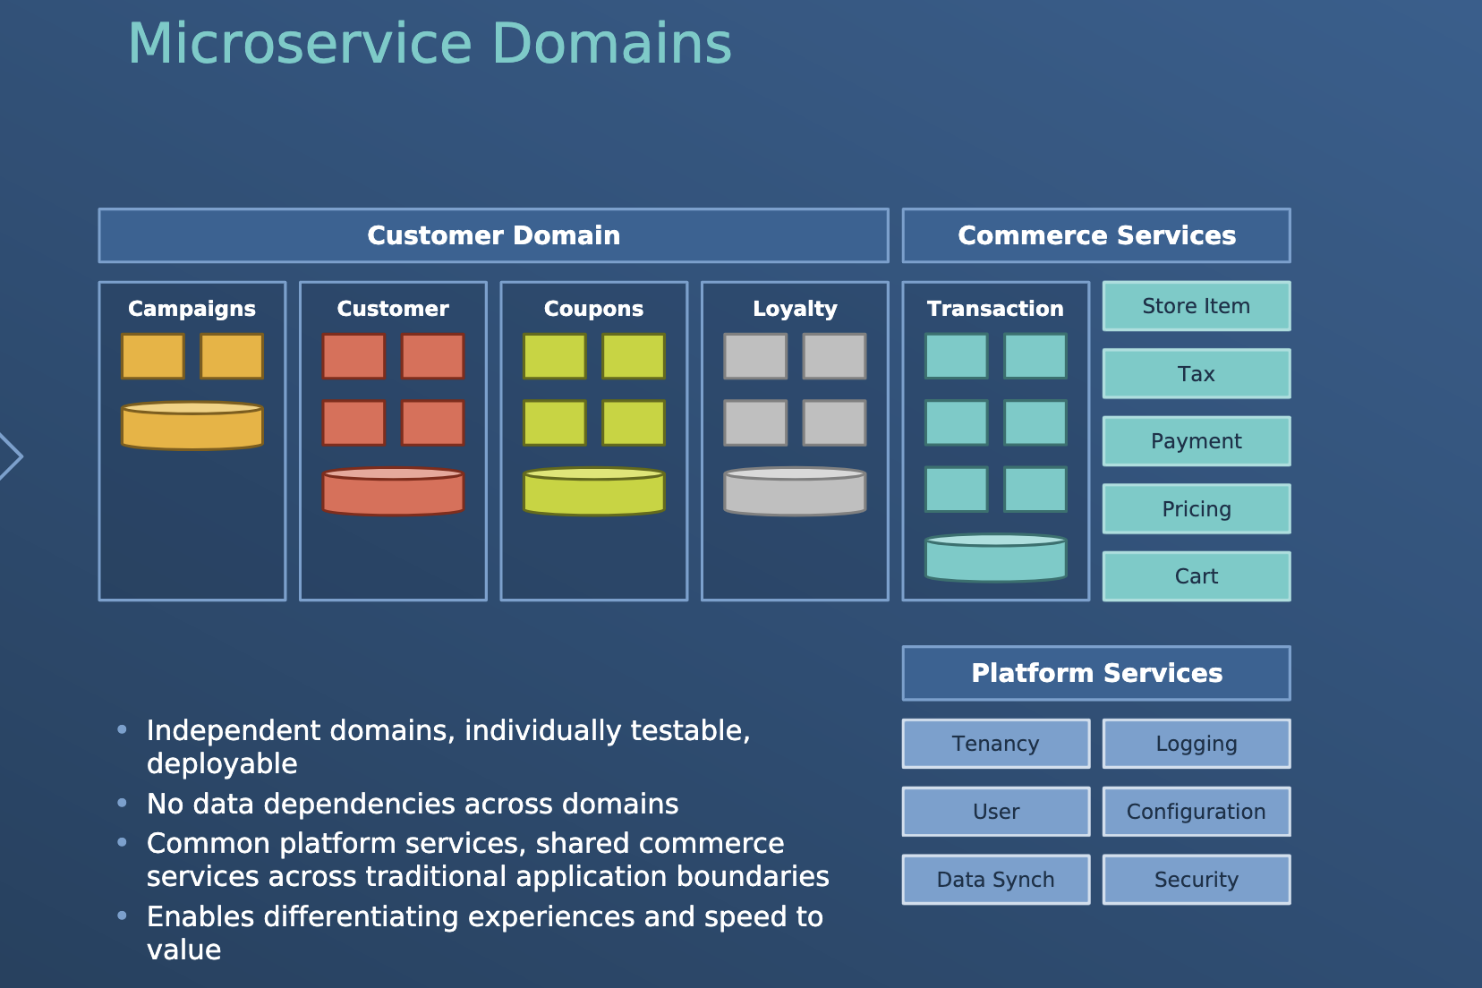
Aptos ONE
Microservice based retail specific platform designed to enable retailers to compete in the complex world of constant change
Application can be structured as a collection of services
Independently scalable and deployable
Loosely coupled
Built based on business capabilities
Robust APIs
Integration with Aptos and 3rd party applications

Slide 23
Aptos ONE
Architectural Theme – Cloud Native
Application built and run on cloud environment
Benefits:
Elastic Scalability
Fault Tolerance
Multi tenancy support
Highly automated operations
Eg: Provision a new device in no time
Eliminates single point of failure

Slide 24
Aptos ONE
Architectural Theme – Omni channel
Provide a seamless shopping experience across all channels, including in store, mobile, and online
Benefits:
Improve Customer engagement and satisfaction
Improves customer experiences
Multi tenancy support
Better brand recognition
Eg: ROPIS, In store pickup + subscribe
Buy online + return in store
Buy in store + return in another store

Slide 25
Aptos ONE
Architectural Theme – Extensibility
Provide Allows to extend services and develop new services while protecting the core platform
Benefits:
Enable innovation
Enable the development of new experiences
Provides tools for faster development of features

Slide 26
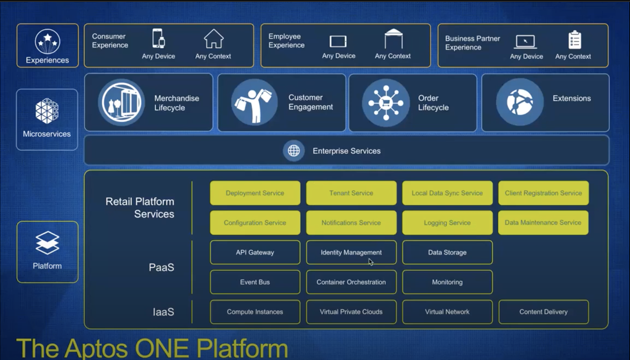
Aptos ONE Platform
IAAS
Foundation of platform
Infrastructure as a service
Provides access to computing resources
PAAS
Run on top of IAAS
Enables robust working platform
MySQL, Key Cloak, RabbitMQ
Platform services
Retail services developed by Aptos
Common platform services, shared commerce service and components
Eg: Deployment service, logging service, Configuration service

Slide 27
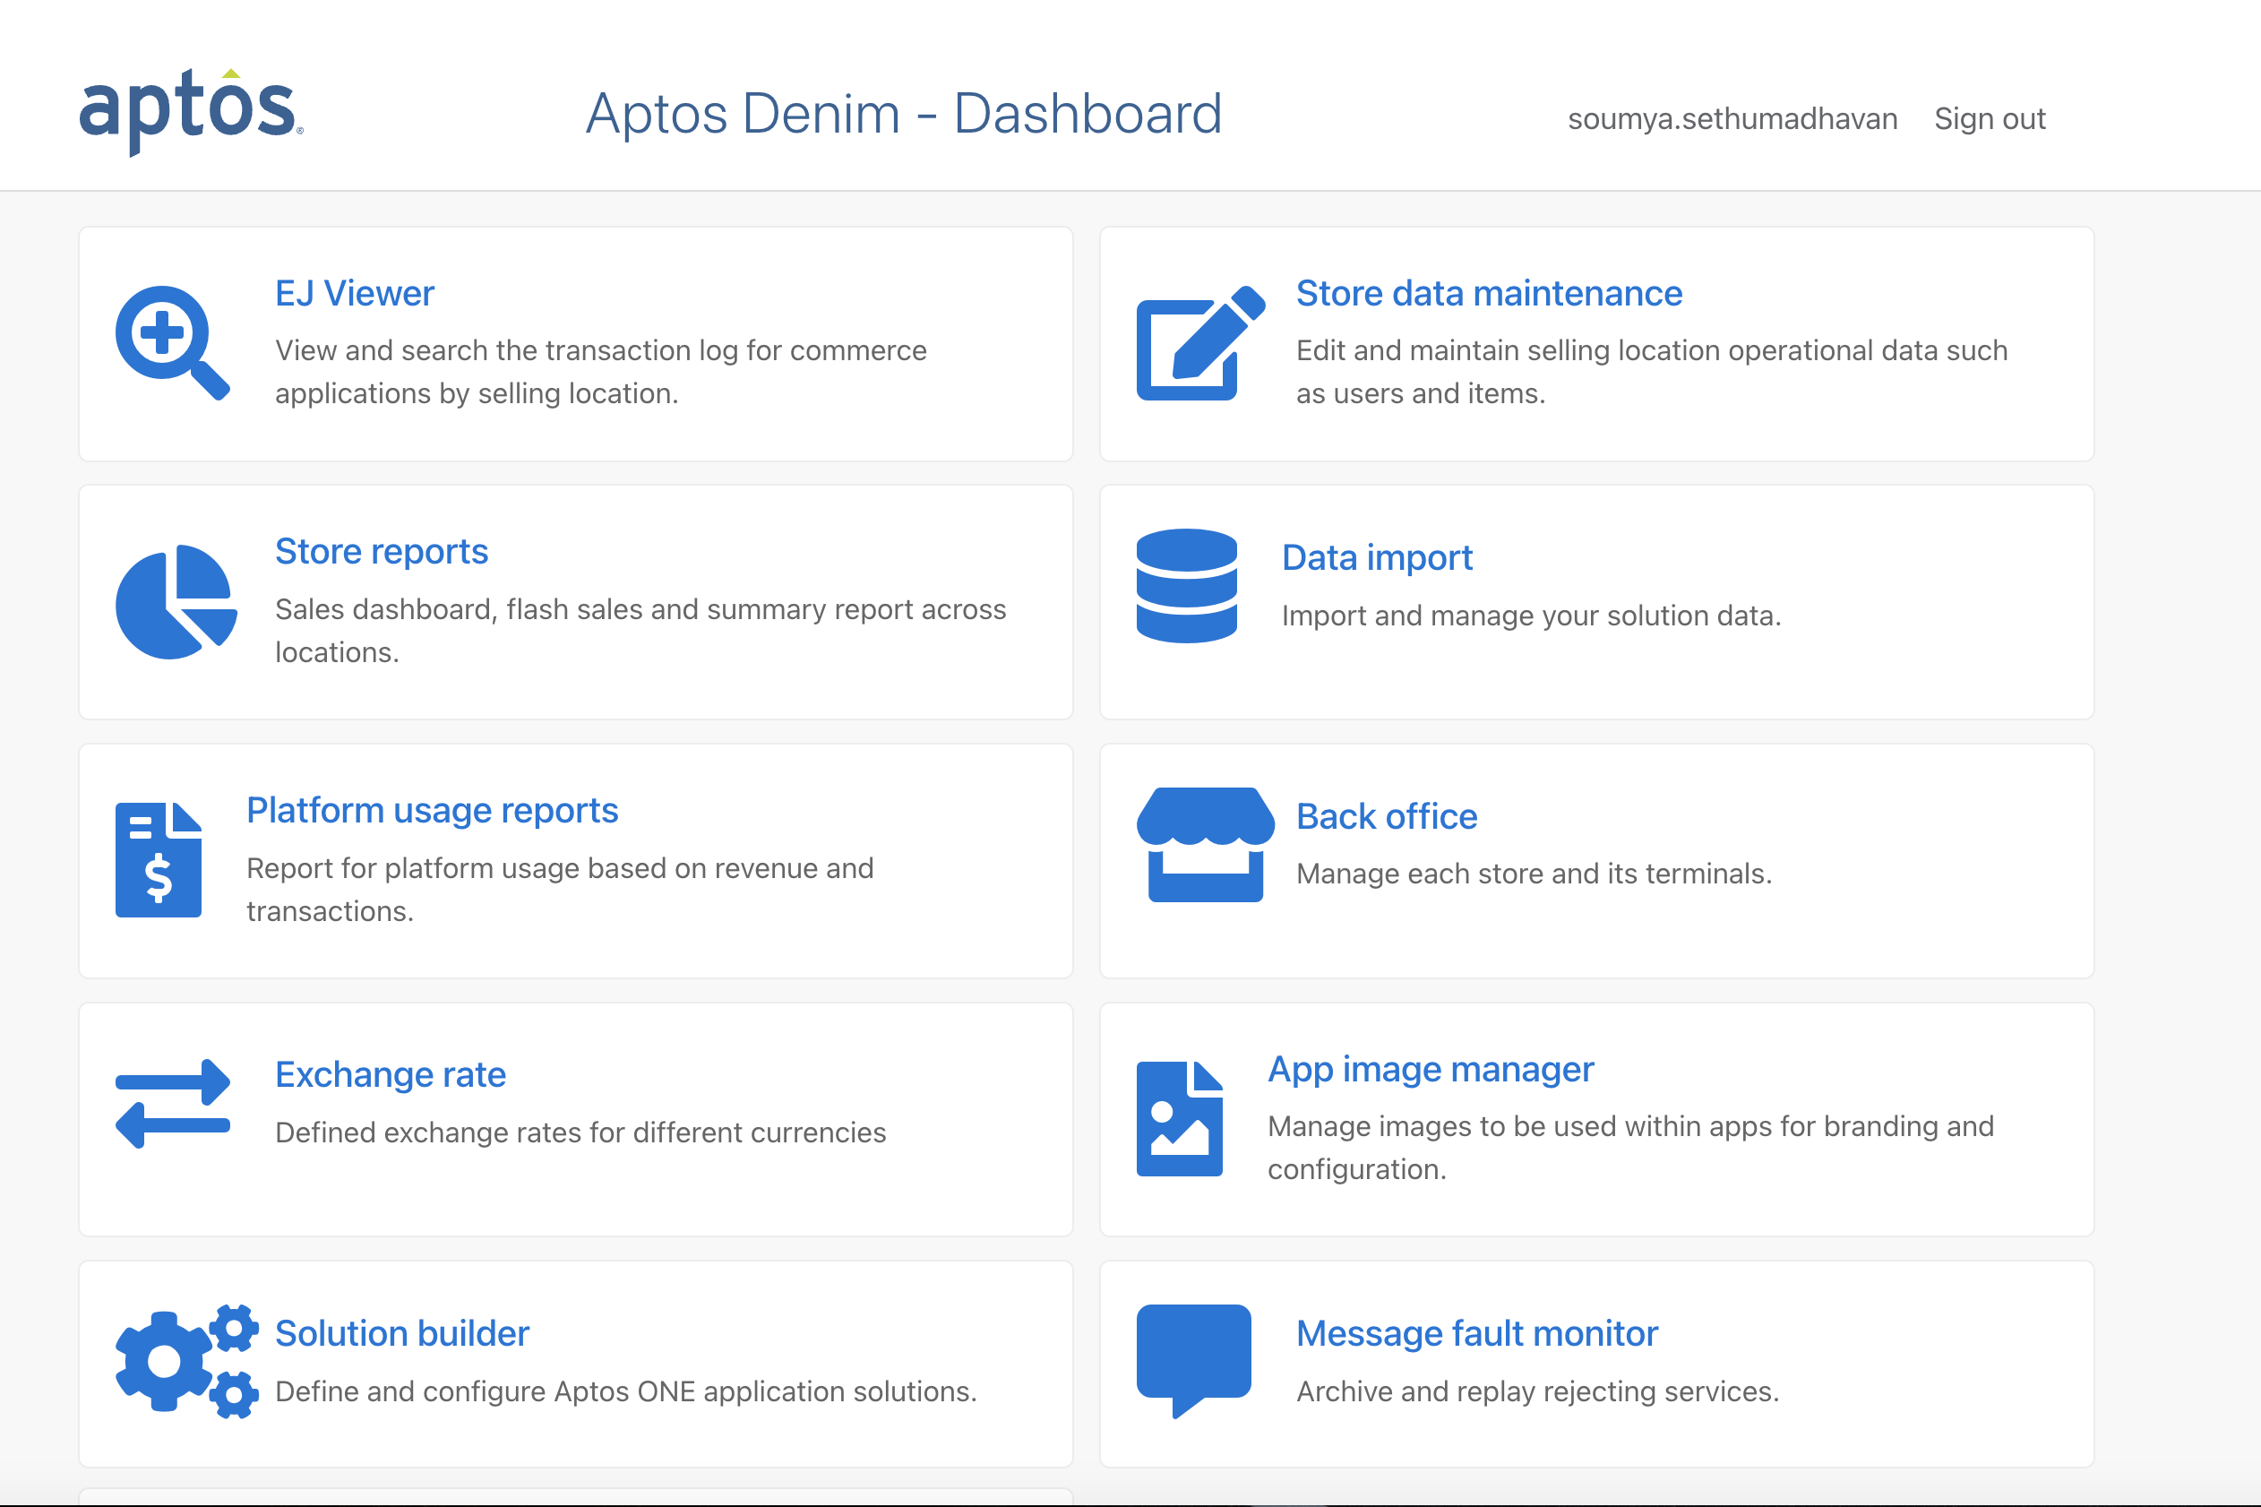
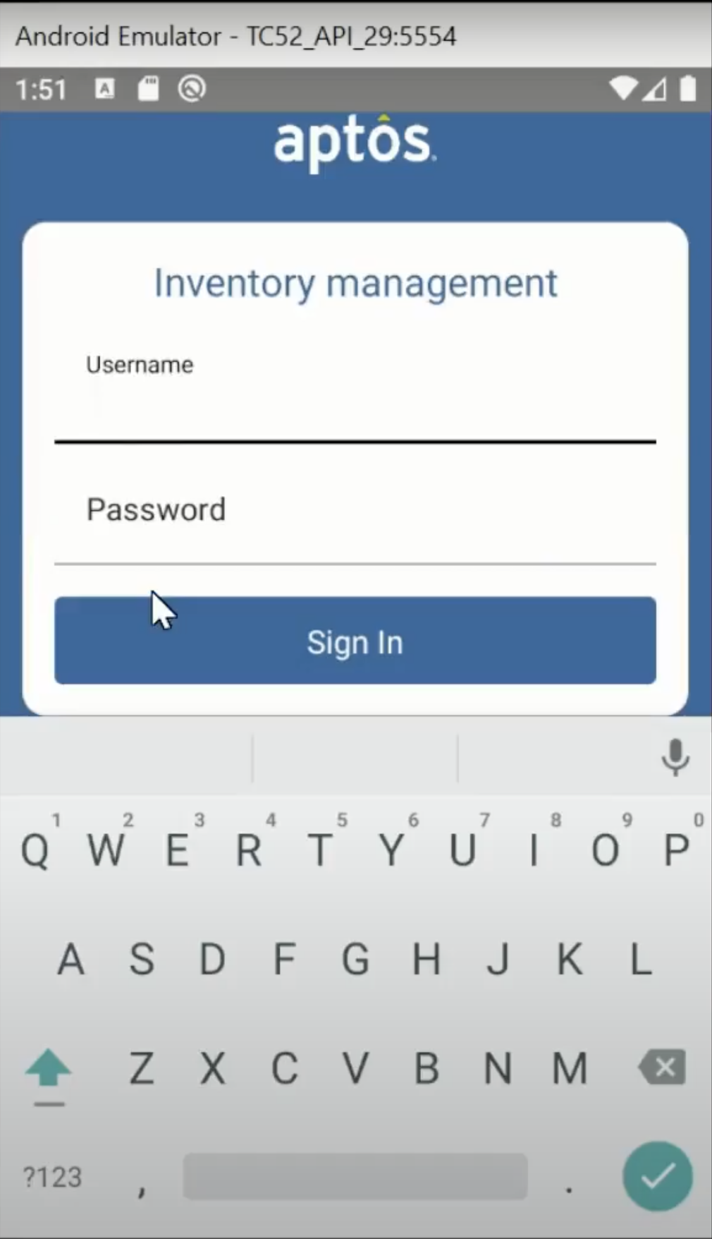
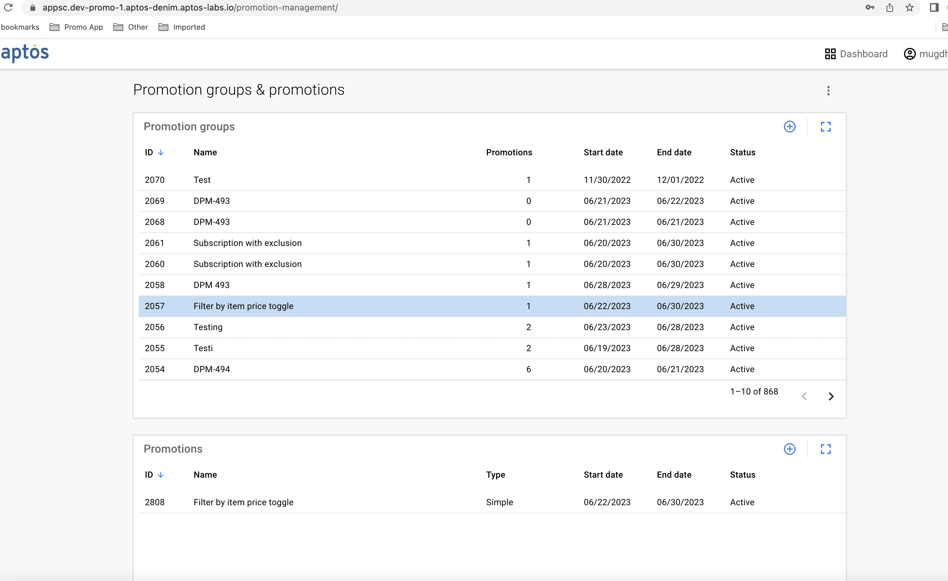
Aptos ONE Applications

Slide 28
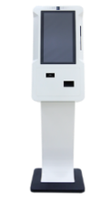
Aptos Unified Commerce Solution
Process layer contains a collection of micro-services that encapsulate business processes
Services have well-defined business goals
Services expose their functionality in a standard way through REST APIs
Services achieve their goals in one of the three ways –
Aptos One Platform
Outside Aptos One
API GATEWAY
API
Aptos One Service
API
Aptos Application
API
Aptos One Service
API
3rd Party Application
Be self-contained and process the request from the clients on its own
Act as connectors with external systems. Called “Facade” in Aptos’ parlance
Orchestrate the tasks involved wherein some are done by them while others through integration
API
Aptos One Service
Experience Layer
Process Layer
External System Layer

Slide 29
Customer Relationship Management

Slide 30
Aptos CRM
Aptos CRM
Information Center
Insights Manager
Customer Data / Inquiry
Campaign Manager
Interactions
Coupon Management
Segmentation /
Query Tool
Loyalty Manager
APIs
Customer Reporting
Privacy Adherence

Slide 31
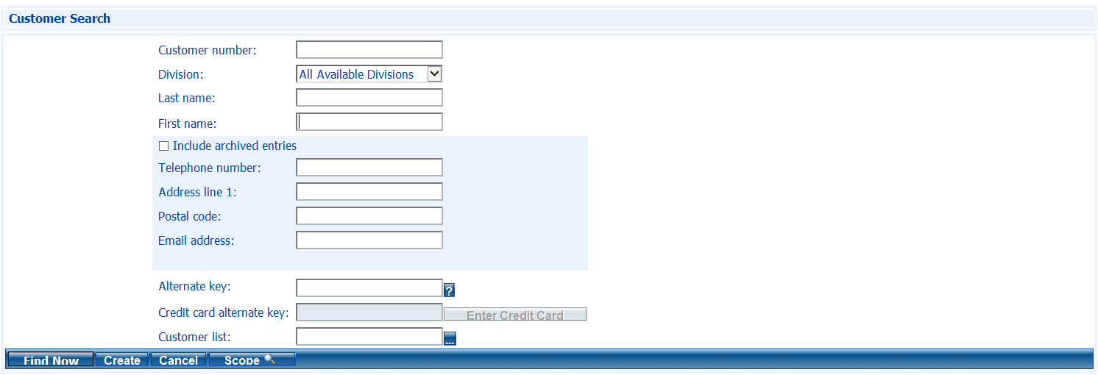
Information Center : Customer Inquiry

Slide 32
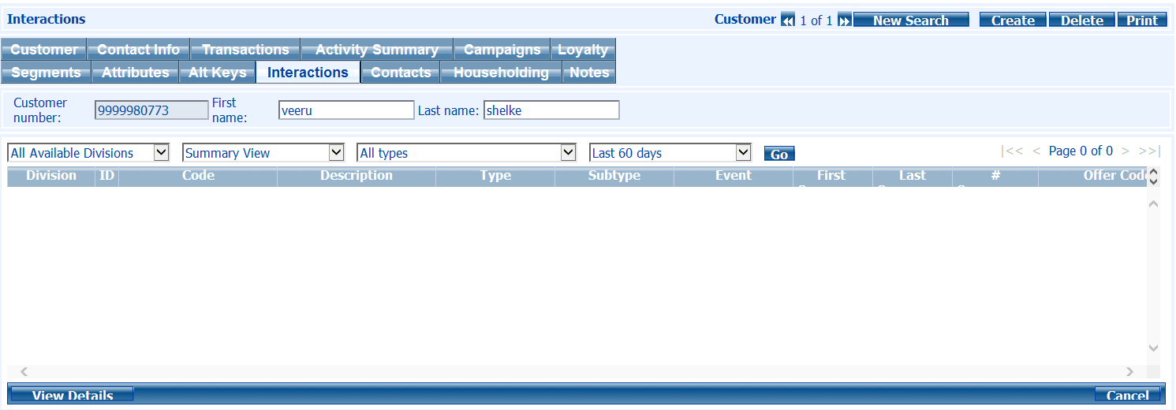
Information Center : Interactions

Slide 33
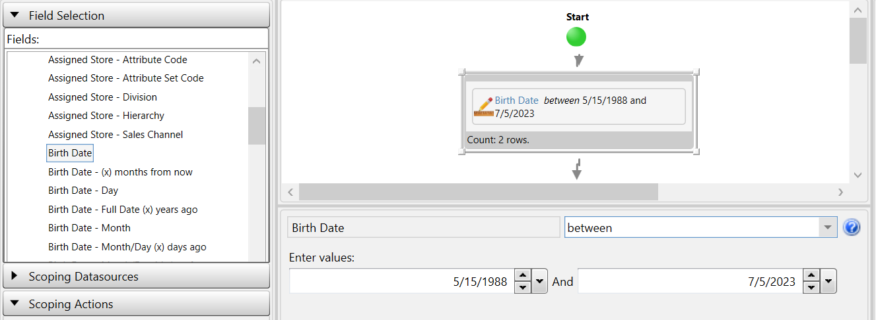
Information Center : Segmentation/Query Tool

Slide 34
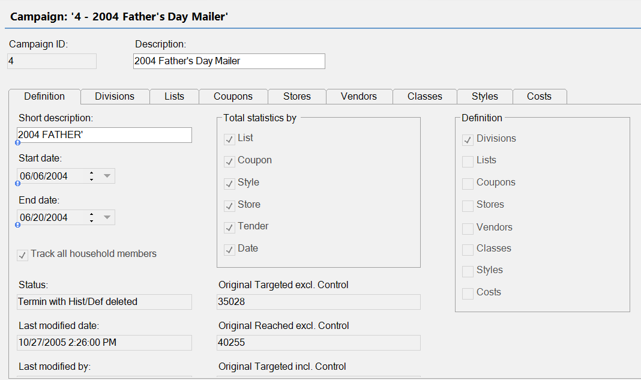
Insights Manager : Campaign Manager

Slide 35
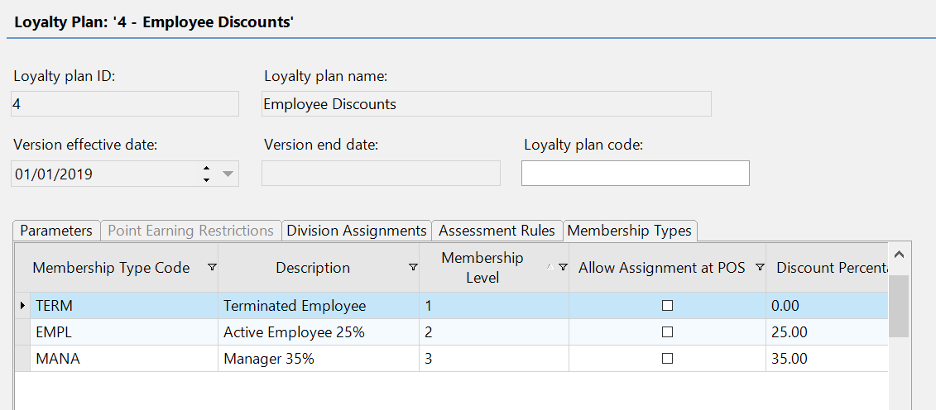
Insights Manager : Loyalty Manager

Slide 36
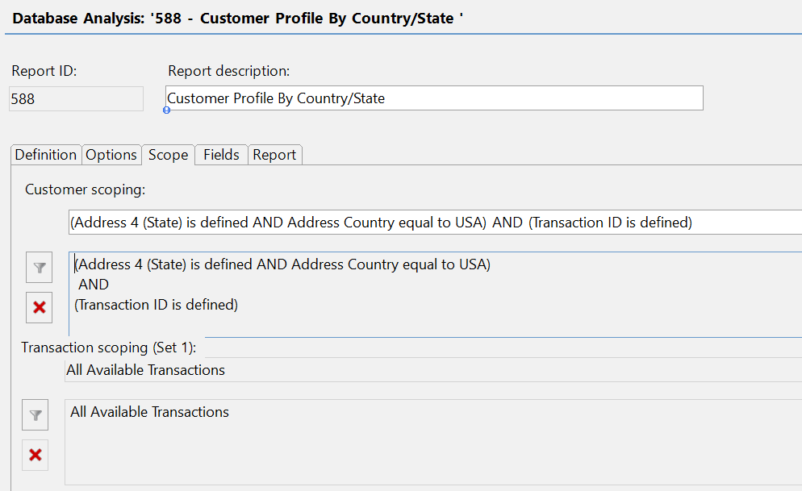
Insights Manager : Customer Reporting

Slide 37
Audit and Operations Management

Slide 38
Aptos AOM
Aptos Audit and Operations Management
Sales Audit
Employee Productivity / Compensation
Loss Prevention
Voucher Management
Guided Audit
Employee Productivity
Events / KPI’s
Gift Card / Voucher Processing
Accounting
Employee Compensation
Dashboards and Reports
Tax
Investigations
Store Performance Analysis
Case Management
Store Operations Security
Customer Liability

Slide 39
AOM : Sales Audit
Sales Audit
Guided Audit
Accounting
Tax
Store Performance Analysis
Store Operations Security
Customer Liability

Slide 40
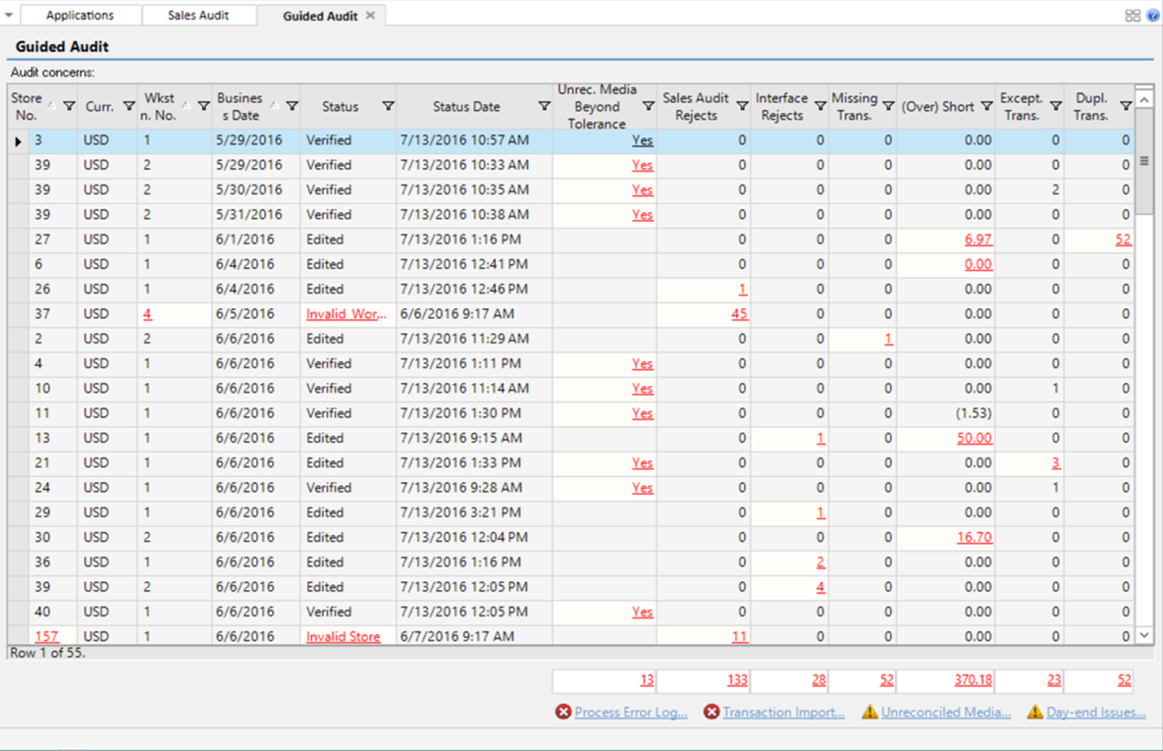
Sales Audit : Guided Audit

Slide 41
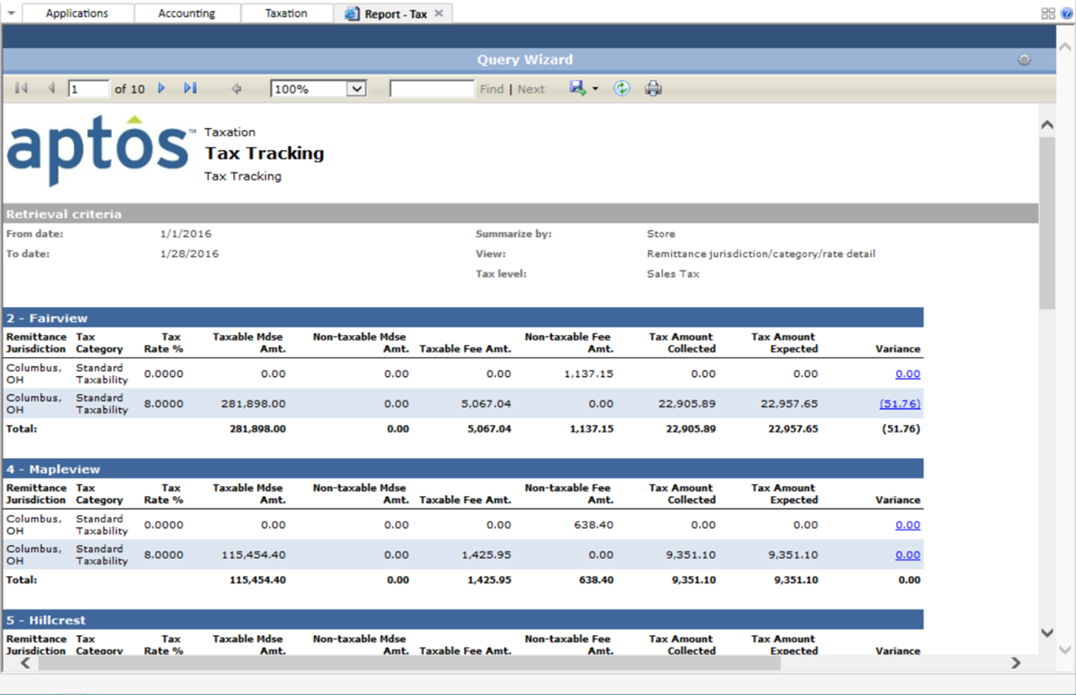
Sales Audit : Tax

Slide 42
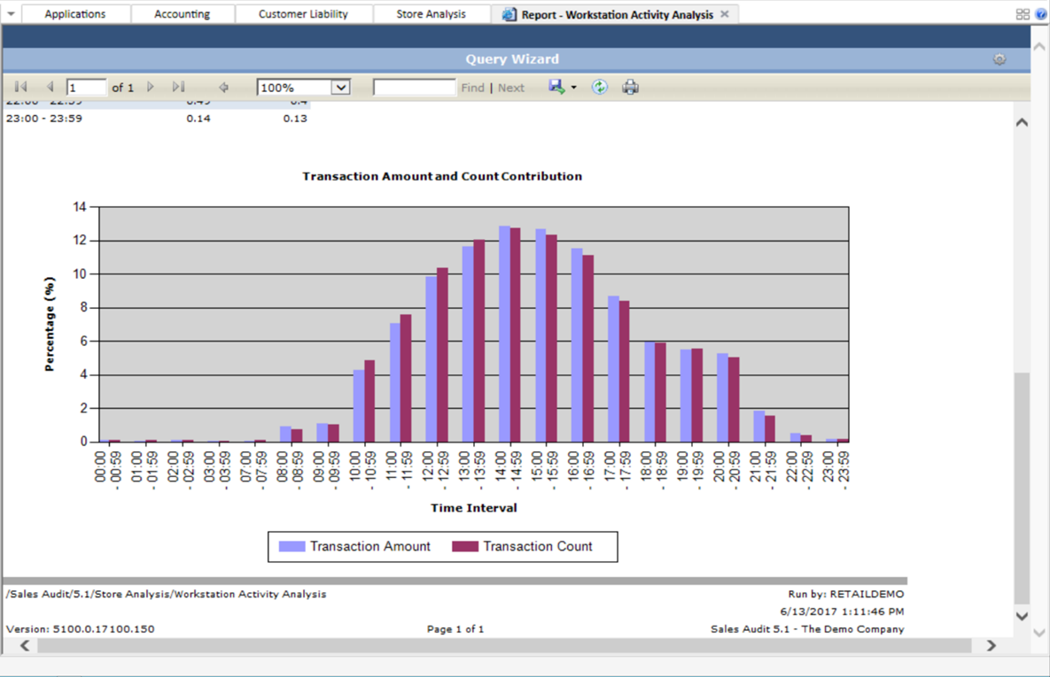
Sales Audit : Store Performance Analysis

Slide 43
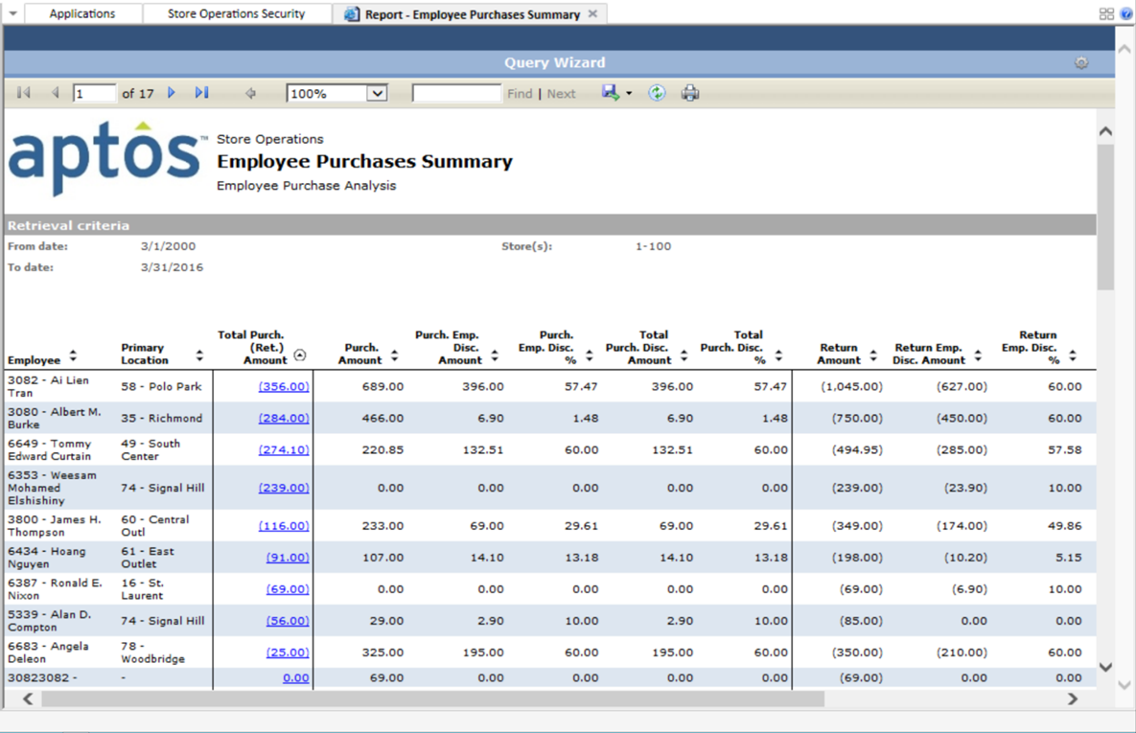
Sales Audit : Store Operations Security

Slide 44
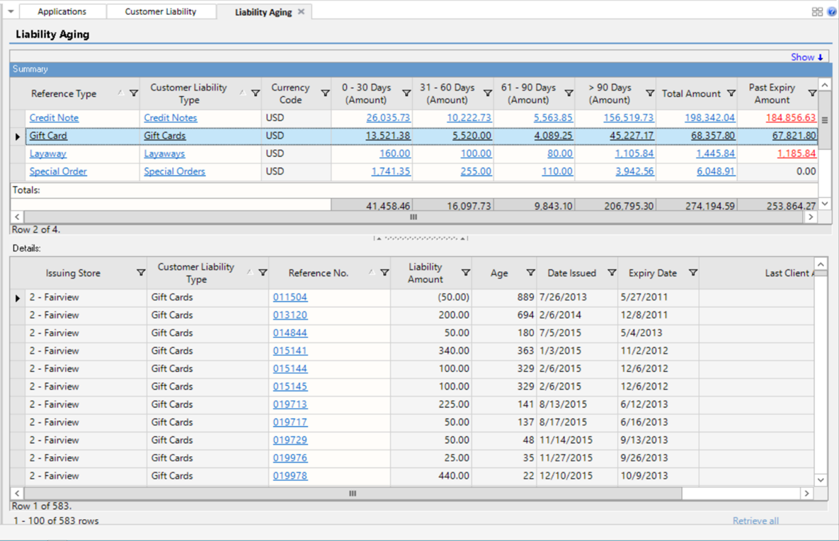
Sales Audit : Customer Liability

Slide 45
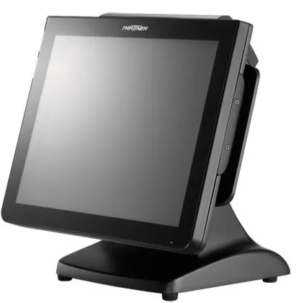
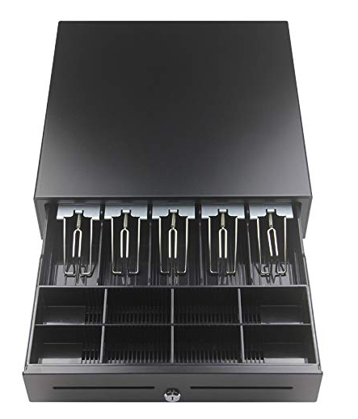


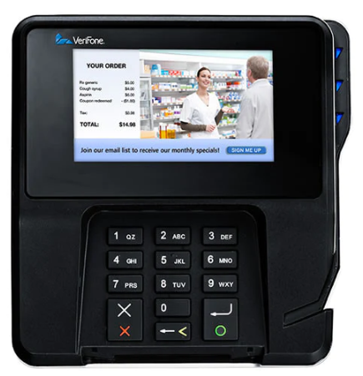
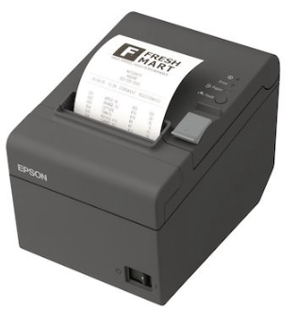
Lab Walkthrough : DEMO
Monitor
Cash drawer
Scanner
Keyboard
Pin pad
Printer

Slide 46
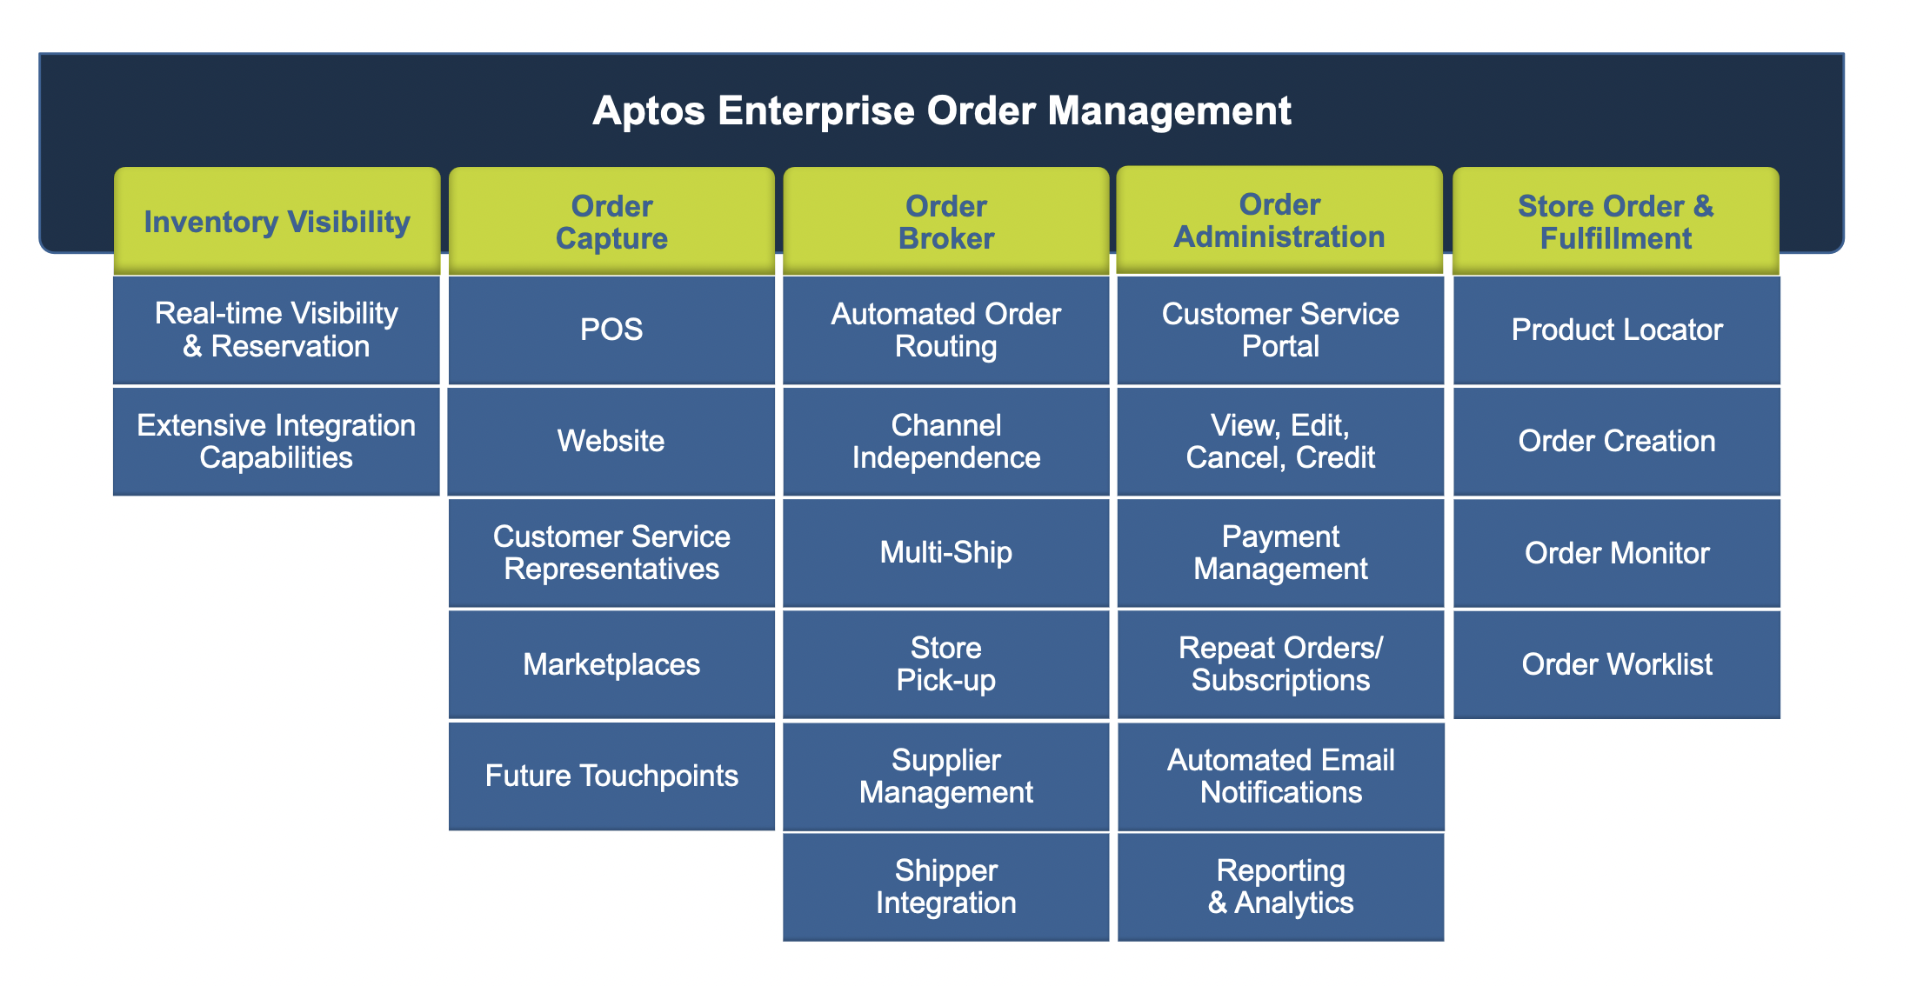
Retail Orientation
Aptos Order Management System
Aptos Order Management System

Slide 47




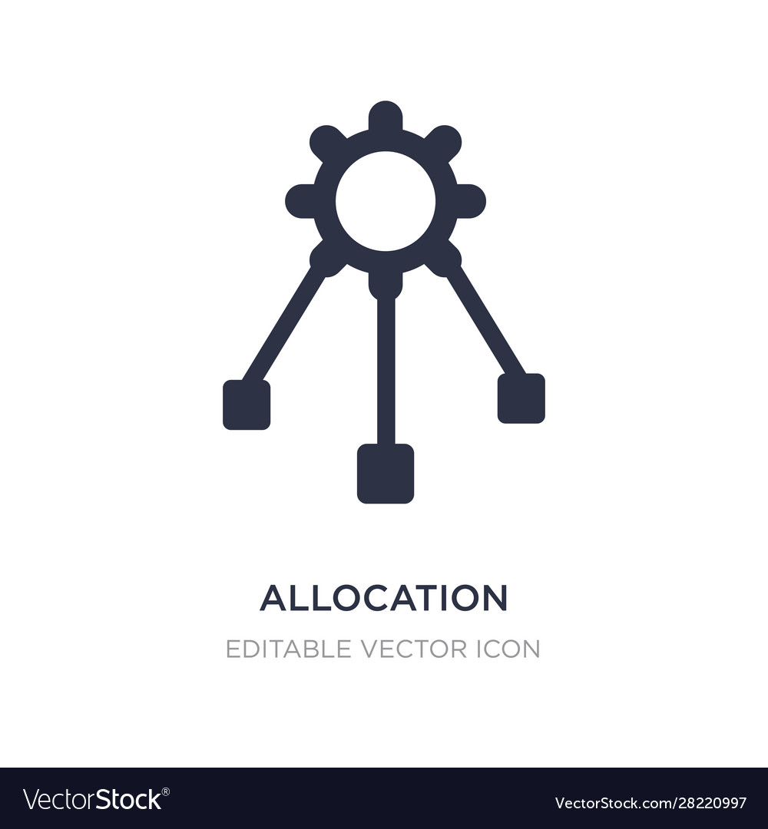

Retail Intro
Blurring inventory silos of channels with OMS
Merchandisers
Customers
Store A
DC
Customers
Allocation
Store B
Inventory is allocated to the individual demand nodes
One demand node doesn’t have visibility to the inventory of the other node
A node only sells the stock it has unless replenished
Customers
Ecommerce
Ecom FC

Slide 48

Retail Intro
Blurring inventory silos of channels with OMS
Merchandisers
Customers
Store A
DC
Customers
Allocation
Store B
As ecommerce gained popularity, OMS emerged as an Order Orchestrator and Order Hub
OMS acted as process controller to -
keep track of progress
determine the next step
translate data
Customers
OMS
Ecommerce
Ecom FC

Slide 49
Retail Intro
Blurring inventory silos of channels with OMS
Merchandisers
Store A
DC
Customers
Allocation
Store B
OMS became a System of reference of inventory
Single source of truth of inventory for all the demand nodes
Provided cross-channel inventory visibility enabling omni-channel use-cases for the retailers
OMS
Ecommerce
Ecom FC

Slide 50

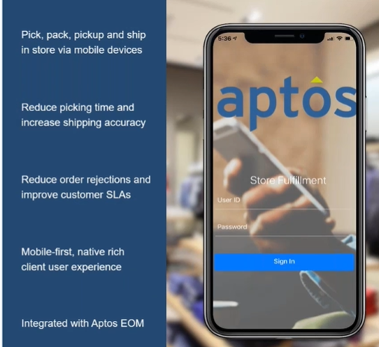
Retail Orientation
Aptos Store Fulfillment App
Store Fulfillment App
Main highlights of the application
Aptos Store Fulfillment integrates with Aptos’ order management solution
Aptos Store Fulfillment offers a faster way to handle fulfillment of orders routed to store locations
With Aptos Store Fulfillment, users can move freely around the store or stock room while performing order fulfillment activities such as viewing the worklist, picking and packing items, validating UPCs, printing shipping documents, and marking items that are out of stock.

Slide 51
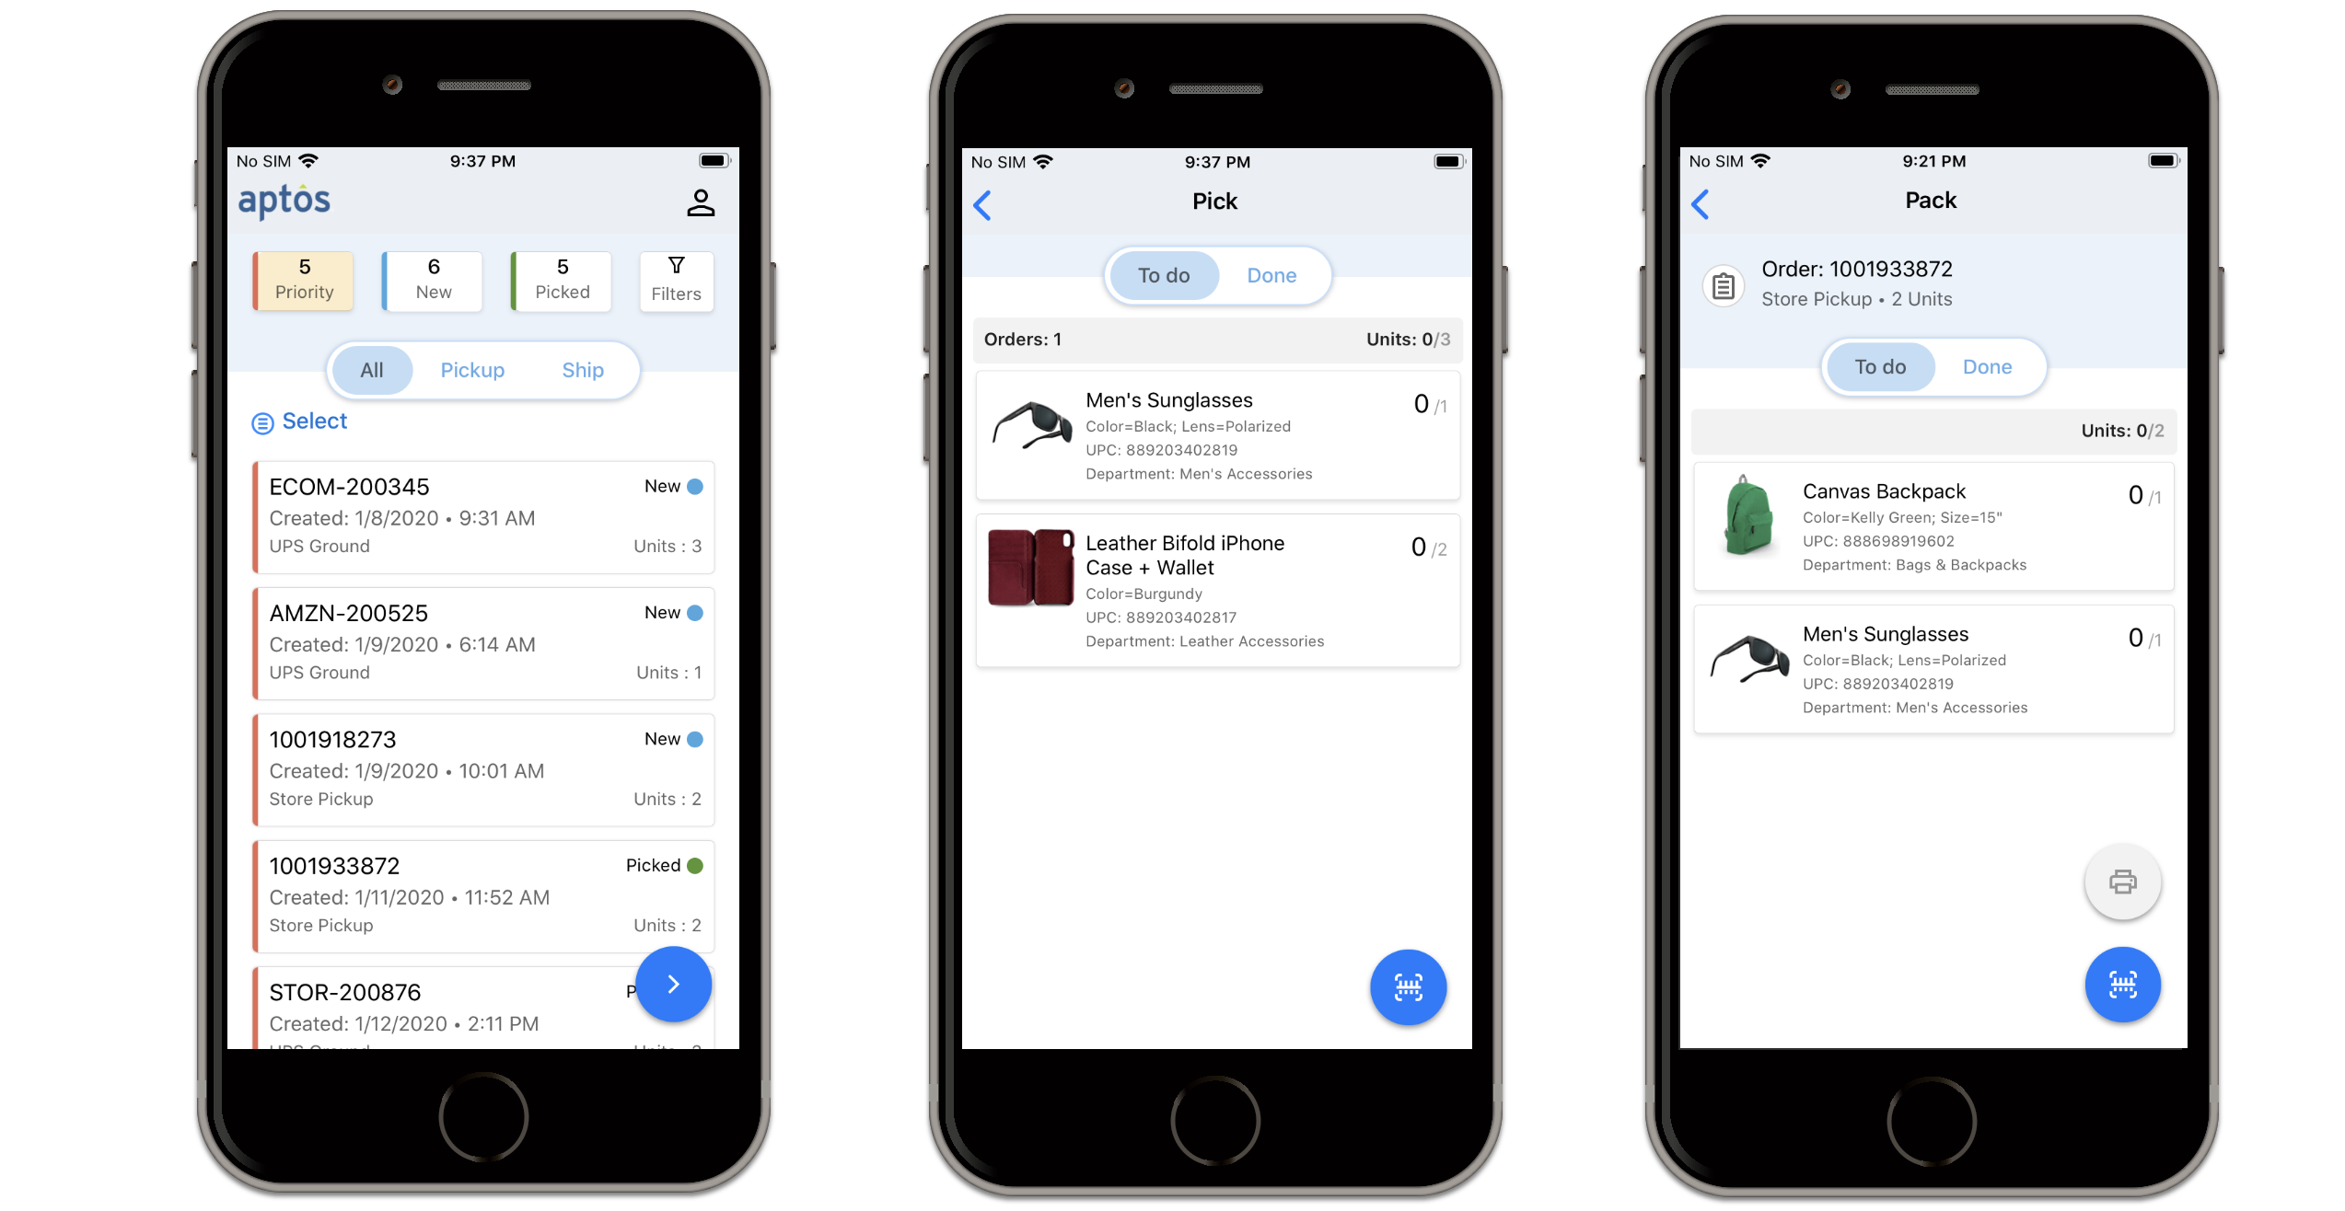
Retail Orientation
Aptos Store Fulfillment App

Slide 52
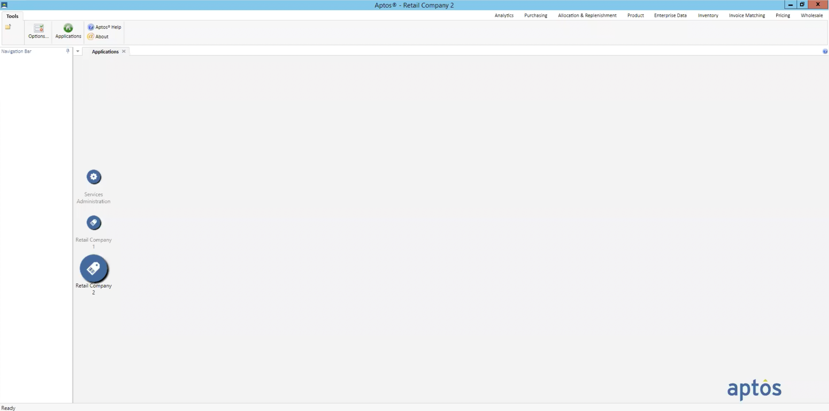
Retail Orientation
Aptos Merchandise
Merchandising
Product & Data Management
PO Management
Price & Deal Management
Inventory Management & Web IM
Allocation
Store Replenishment
Invoice Matching
Stock Ledger;

Slide 53
Retail Orientation
Aptos Merchandise
Merchandising
Product & Data Management
Product Management
Hierarchy, styles, colors, sizes, UPCs
Enterprise Data Management
Locations, suppliers, calendar, user tables
Purchase Order Management
Create, approve and transmit/release to vendors
Invoice Matching
3-way match, configure criteria, parameters and reason codes
Distributions/allocations
Pre/post-allocate
Store grading, location protection, location eligibility
Distribution methods – manual, assortment based, min-max and actual selling
Automated Replenishment
schedules, forecasting, vendor reviews
Pricing
Maintain regular and promotional price, create permanent and promotional changes, create deals,
Ability to price styles down to style/color/size/location
Create price change document
Inventory Management
Inbound worklist – PO receipts, ASN receipts, Store Shipments, Unsolicited receipts
Outbound worklist – Transfers, RTV, IMRDs
Adjustment – Adjust on hand due to shrinkage or stock status
Cycle counts and full inventory counts – ICD, import count, run shrinkage report, variance and adjustment
Web Inventory Management available in-store
Stock Ledger
Reporting of cost of goods sold, receipts, shrinkage, etc. to General Ledger
PO Management
Price & Deal Management
Inventory Management & Web IM
Allocation
Store Replenishment
Invoice Matching
Stock Ledger;

Slide 54
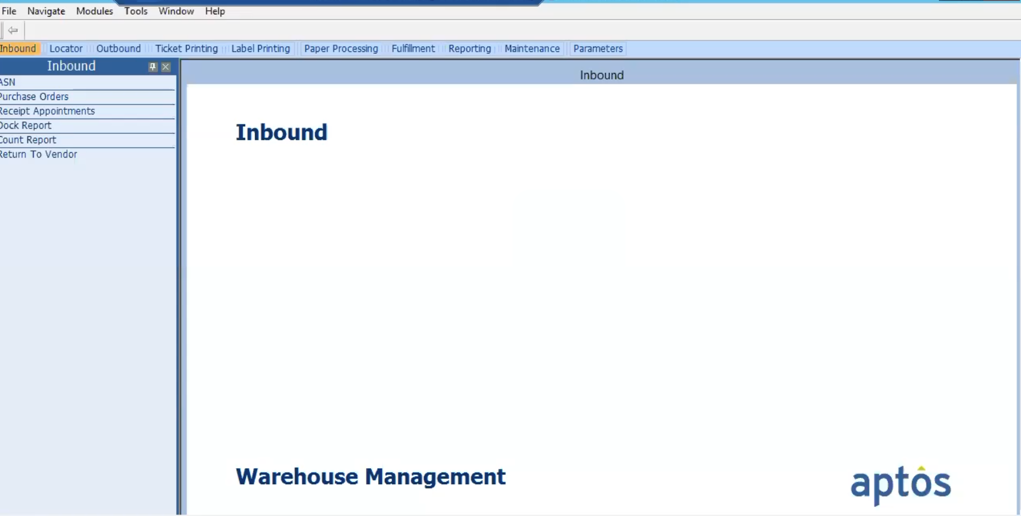

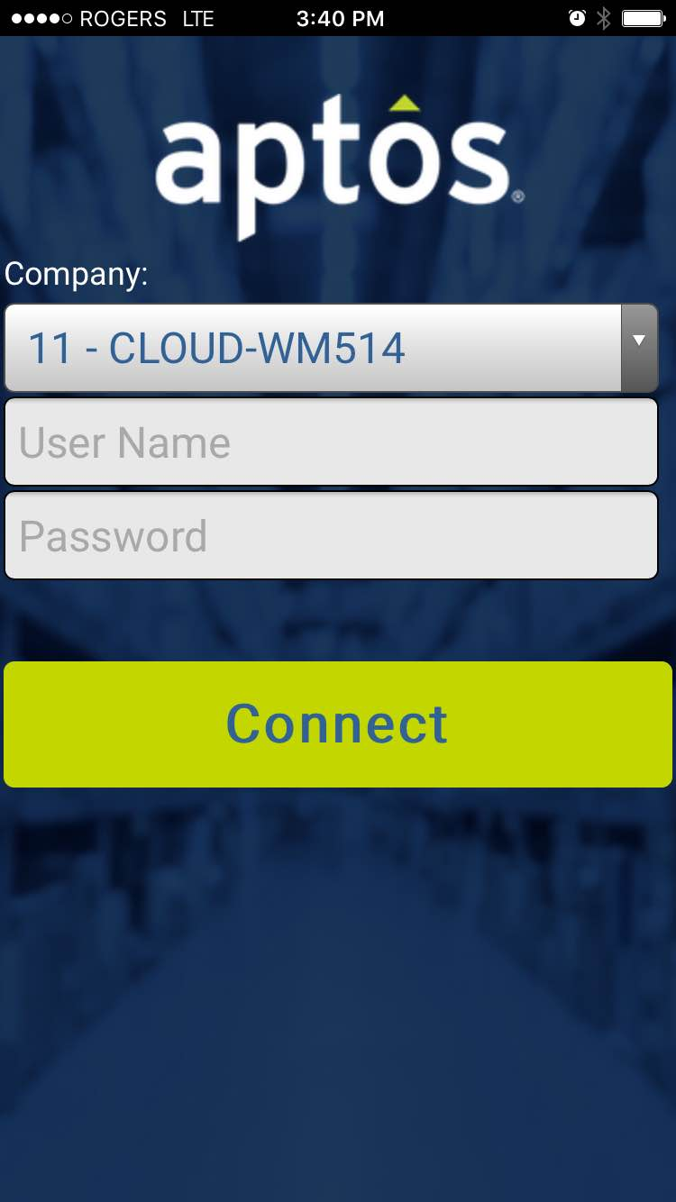
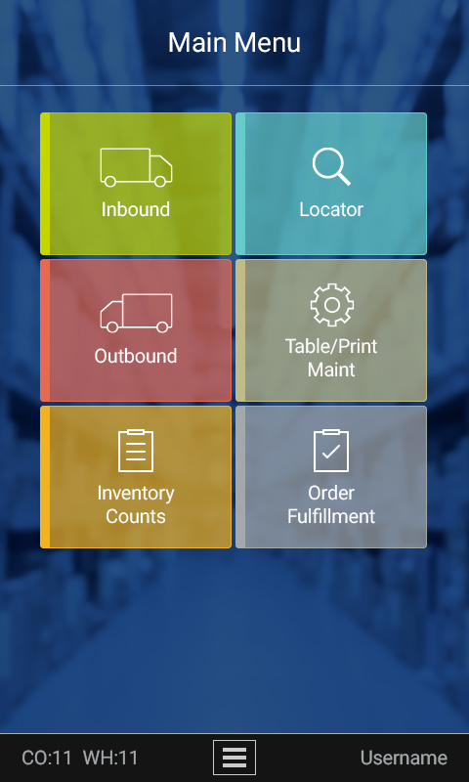
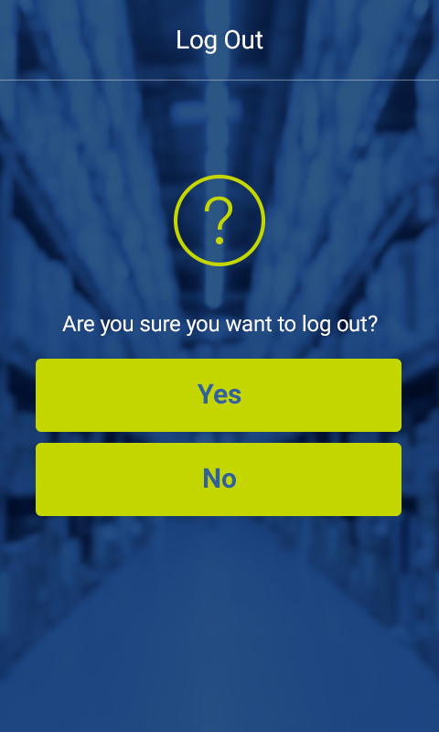
Retail Orientation
Aptos Warehouse Management System
Warehouse Management
Inbound
Reserve Locator
Outbound
Inventory Control
Order Fulfillment
Handheld Terminals

Slide 55
Retail Orientation
Aptos Warehouse Management System
Warehouse Management
Inbound processing Appointment scheduling, dock/detail receiving, ticketing, vendor compliance Flow-through receipts, put-away
Locator processing Look up inventory, retrieval task creation and assignment Retrieval types, retrieval task completion
Outbound processing Packing distributions Customer order fulfilment Stage/load/close shipments, shipment documentation
Directed cycle counts
Physical inventory counts
Returns to vendor
Inter-warehouse transfers
Store-to-warehouse transfers
Adjustments
Inbound
Reserve Locator
Outbound
Inventory Control
Order Fulfillment
Handheld Terminals

Slide 56
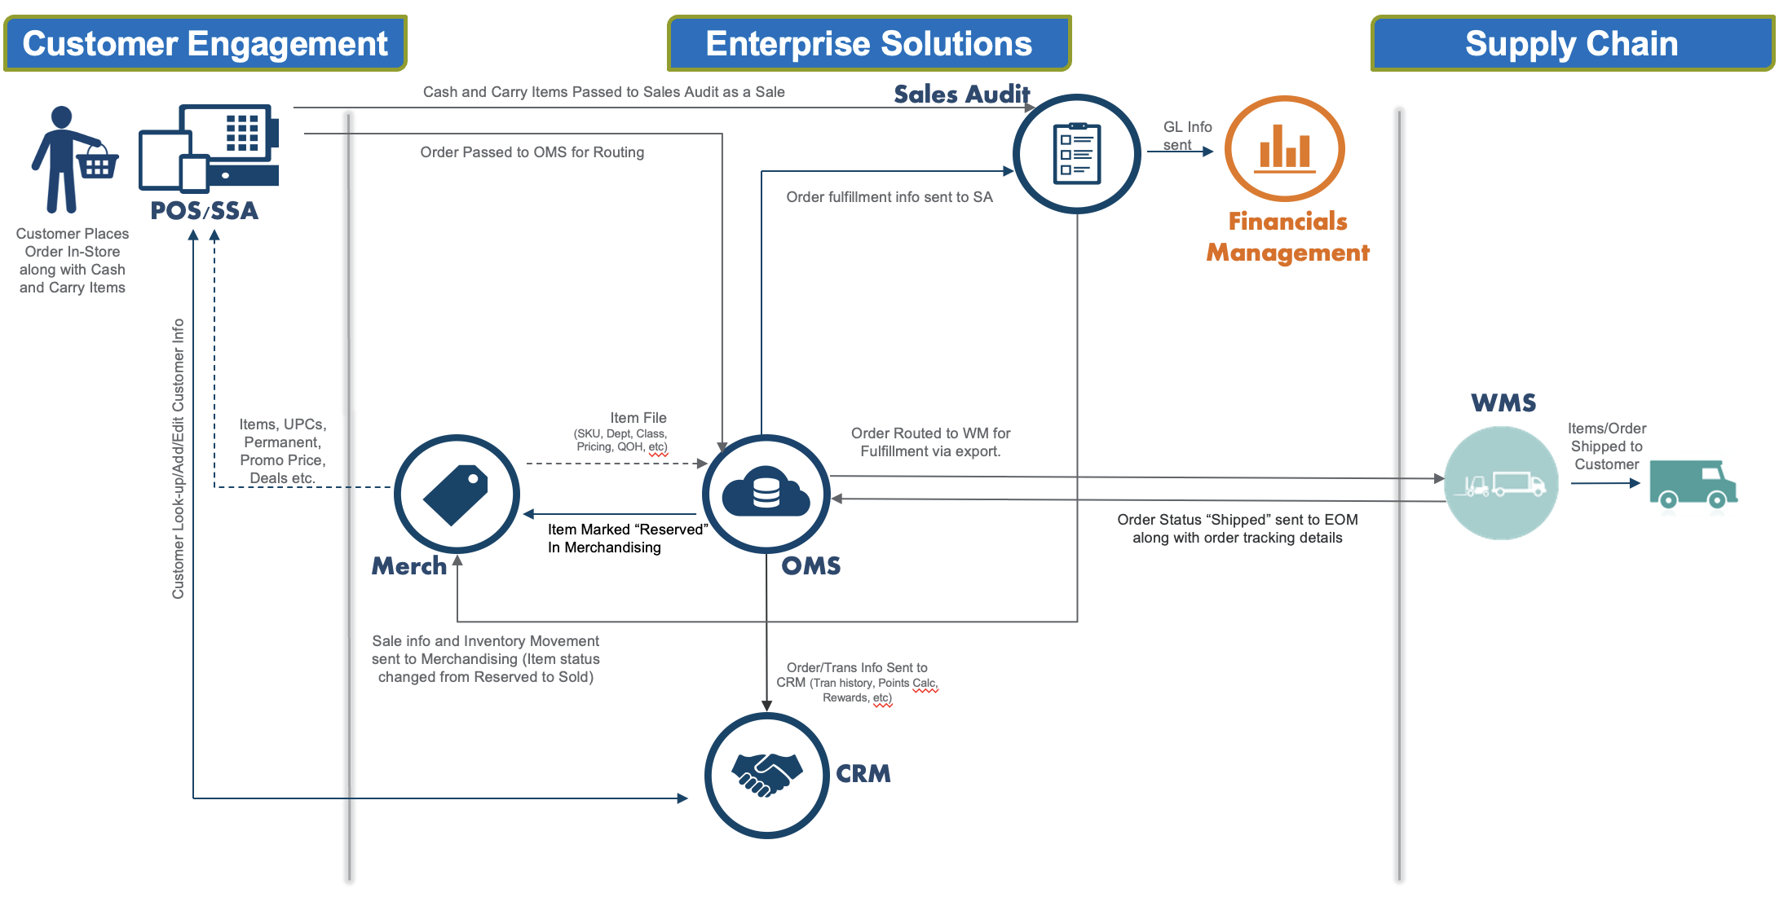
Retail Orientation
Integration landscape of Aptos Solutions – use-case based illustration
Mixed cart with Cash and Cary and Order items (Buy In-Store and Ship to Customer from Warehouse)

Slide 57

Retail Intro
Integrated view of Aptos Solutions (detailed)

